Slide 1
Teachers of Morse Code
Helping Make CW Great Again
Worldwide via Zoom Internet Video Conference Classes
Prepared by Instructor W6JIM

Slide 2
Who we are
Over 1700 Members
50 States
29 Countries
48 Teachers
Men, Women and Kids
Experts & Rookies
Techies & Nostalgic
Young & Old
From PhDs to Retirees
We all share the love of CW & create an extraordinary synergy

Slide 3
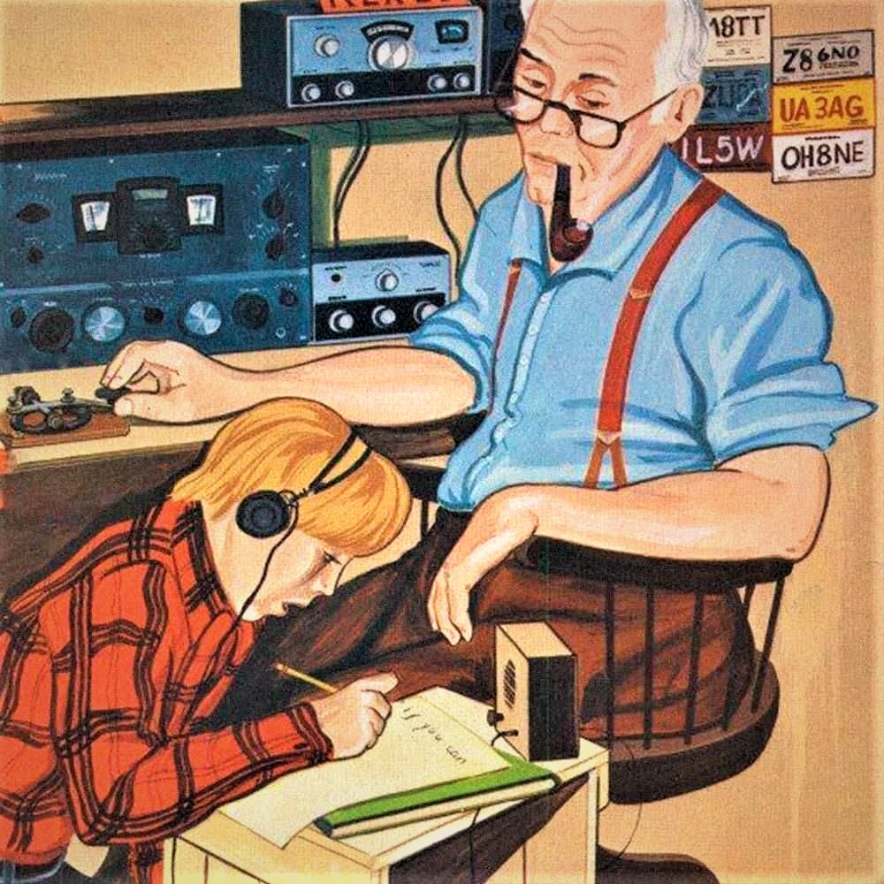
How we started
2018 - Promoted CW in & around the New York metro area
We found great demand
Began classes via video “Zoom” conference
Also many 'brick and mortar' events:
QRP & POTA Outings, BBQs w/Portable Ops, Fireboat Activations
Live-Stream Build-A-Thons, Museum Visits, Marconi Day

Slide 4
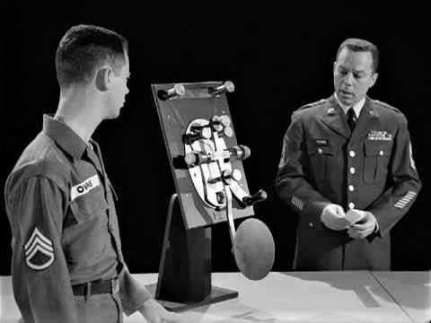
rapid growth
Currently:
Over 1700 Members, 50 States, 29 Countries
Classes have increased to 75 per week

Slide 5
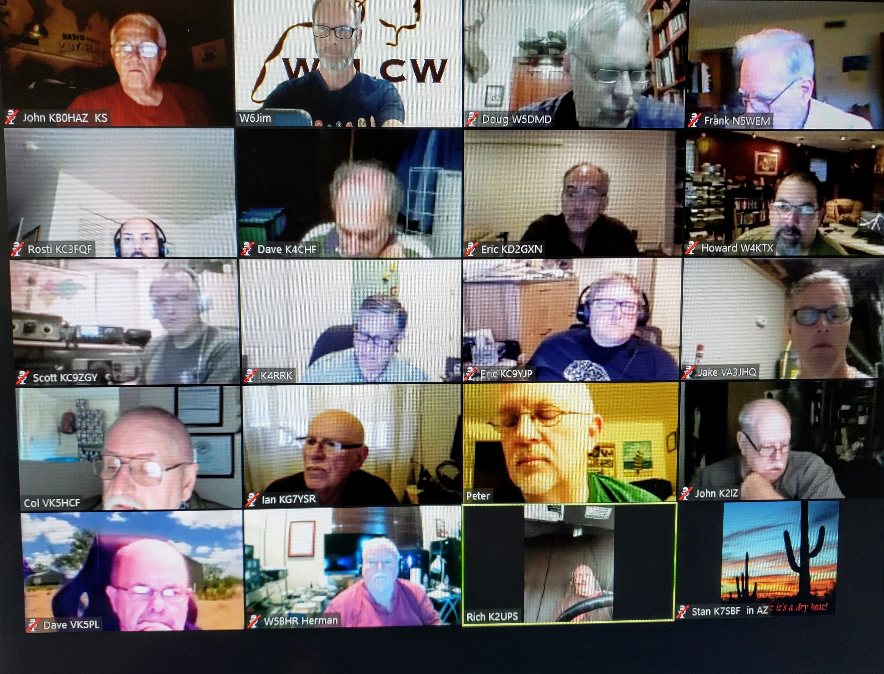
Classroom
Students log-in
Computer or Cell
Webcam and Mic
Key or Paddle & Oscillator
Capacity – 100 students!
Operates like normal classroom

Slide 6
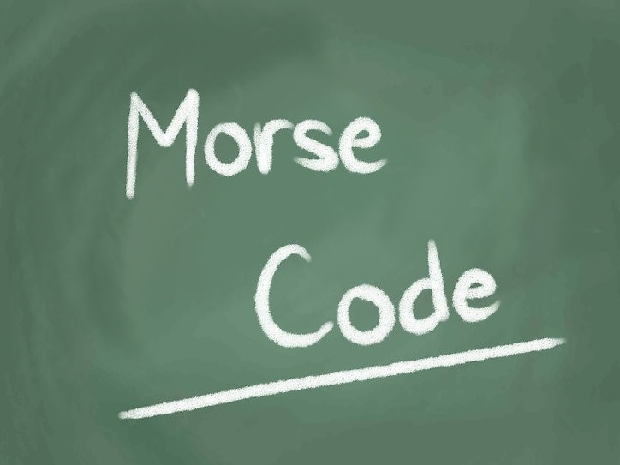
Classes
75 adult classes per week!
Presentation Series
Beginner – Intermediate - Advanced
Round Robin Sending
Head Copy for QSOs
Informal Rag-Chew
Women's Only
Friday Fun with CW
Live QSO Classes!
Breaking 11-15wpm Barrier
CW Workshop
20/20 Class
20+ Class
Demystifying the QSO Class
And More!
Boat Anchors
QRP
Contesting
Modern Ham Radio technology
Mag loop antennas
Dxpeditions
Satellites
Ham Radio Nostalgia
POTA and SOTA
Bugs and Cootie Keys
And More!

Slide 7
Teaching home bound kids Morse Code
Due to COVID-19 concerns, LICW has stepped-in offering free on-line instruction in Morse code.
- 6-9 Kids classes per week Beginner & Intermediate
- Grades K-12
- Over 350 students taught, USA and internationally
- Some have made CW QSOs already and gotten their Technician and General licenses

Slide 8
We have Ladies only CW classes
- Over 100 YL Club Members!
- Designed to encourage our YLs
- Friendly & synergistic environment
- 60% of our kids program are girls -- very promising!

Slide 9
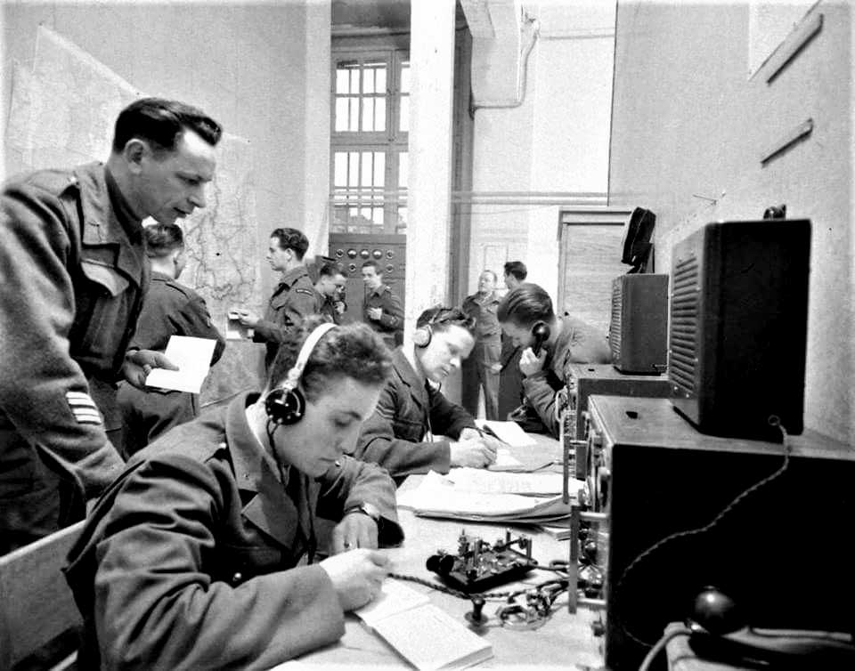
How do I get started?
Request to join
A return email will be sent with a full description of the organization
Donation is $30.00 per year and Lifetime is $90.00
Zoom
G4FON trainer
Straight key and/or paddle-keyer
Oscillator or radio side tone
Try to attend 2 classes/week & practice 15-20 minutes/day

Slide 10
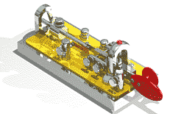
hpe cuagn vy 73 de w2lcw tu sk . .

