Slide 1

LICW
TEACHERS of Morse Code
Notes:
Today I would like to tell you about the Long Island CW Club and the renaissance of Morse Code

Slide 2
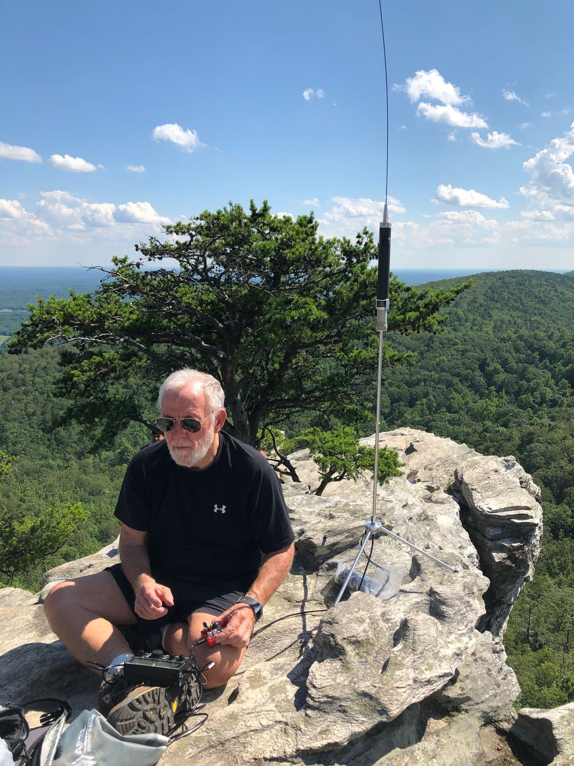


THE Renaissance of Morse Code
Morse Code in a hi-tech world
International reach
Reliability
Nostalgia
Portability
SOTA/POTA
Jim N0IPA activating Mt. Sherman 14,000’
Bob K4RLC activating Hanging Rock State Park
Notes:
Morse code is making a comeback in today's tech-driven world. In this presentation we share our research and insights behind the development of our beginner's curriculum, which incorporates The LICW Method—an approach specifically designed to give adult learners the best chance for success and help them get on the air quickly.

Slide 3
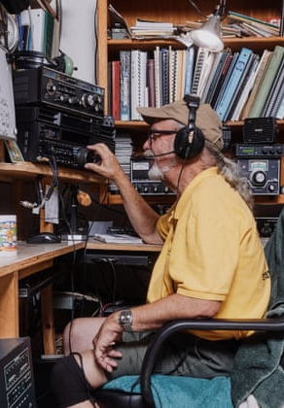

Why Should I Learn Morse Code?
It’s Fun!
A rewarding skill with a strong community
Low power & modest antenna offer Big Results!
Works even in poor signal conditions
It is the original operating mode of Ham Radio
Connection to the origins of radio communication

Slide 4
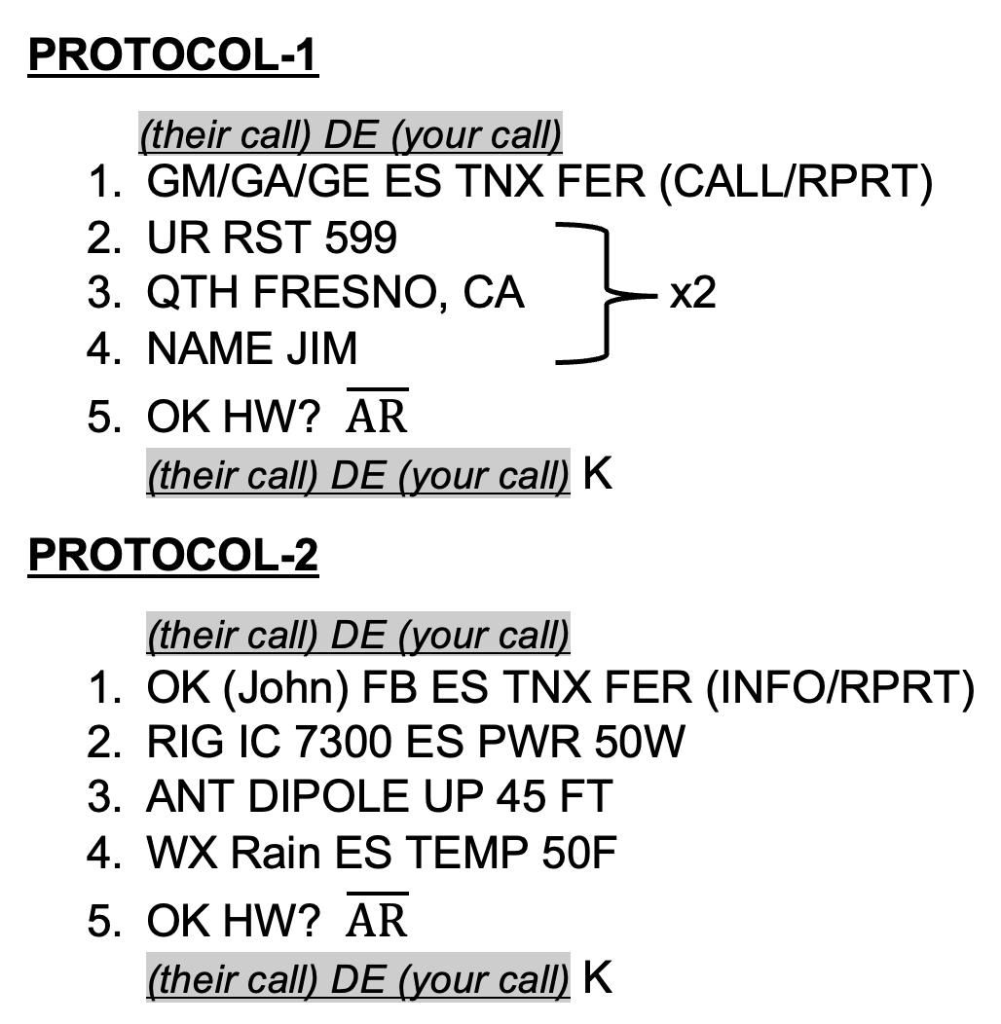
What Are We Saying in Morse Code?
Messages can be simple to conversational
The Exchange
Short vs. Long
Often just a signal report and our location
POTA, SOTA, DX …
Standard QSO (Conversational)
1st exchange: RST (signal report), QTH (location), Name
2nd exchange: Rig (radio), Antenna, Weather
Ending: A polite goodbye

Slide 5
Is It Hard to Learn Morse Code?
Commitment of time is required
Fluency
About a year of regular practice
Achievable!
Basic proficiency
Mastery
About 4 months to get on the air
Several years, but the journey is rewarding!

Slide 6
Licw TEACHING MethodS
Teaching methods video
Notes:
You may speak to the next slide or play this 17-minute video:

Slide 7
The Licw Method
Character Introduction in the Koch Method (single letter)
12 WPM
Character sequence based on QSO Protocol
Ensure characters heard as single acoustic sounds
Establish character sound familiarity
Character Recognition with focus on ICR/IER
Time to recognize and not dwelling on errors
Notes:
And so now you have seen how we introduce characters one at a time in the Koch Method. At Koch’s recommended 12 WPM. And in a sequence optimized for initial learning. How we ensure the new characters are being perceived as single acoustics sounds. How we establish character sound familiarity before finally transitioning to recognition or copy with a focus on time to recognize and not dwelling on mistakes. And we do this methodically for each Morse character. Combined, we refer to this as The LICW Method and we believe it gives the adult learners the best opportunity for success to deeply learn the code and achieve proficiency.

Slide 8
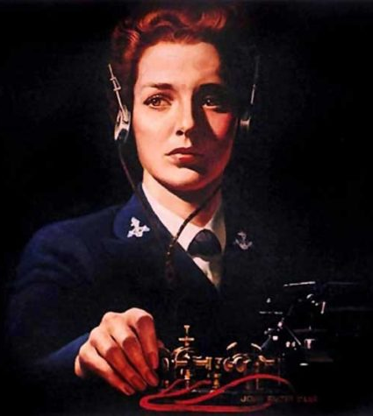
A Little Bit About Our Club
Founded in 2018
More CW operators needed / Field Day in 2017
A way to give back to the community
Goal: 50 members / Long Island area
More successful than we ever dreamed
Over 6000 members
All 50 US States
Over 60 countries around the world
Over 100 Instructors and Moderators
Over 150 Classes/Forums weekly on Zoom
English & Spanish

Slide 9
Club Resources
LICW YouTube Channel
LICW Newsletter
LICW Facebook Page
LICW This Week Podcast
LICW Discord Server (Chat, Sked)
LICW DMR: TGIF Network, Talk Group
LICW Dropbox
LICW Groups.io
LICW Morse Practice Page
LICW VBand Channel Page
LICW Challenge Page
LICW Academic Downloads

Slide 10
Beyond Core Curriculum
Intro to Club Resources
Foundational Classes
Sending Prep
Building Productive Practice Habits
Sending Fundamentals
Women's Only
Hams with Disabilities
National Traffic System
London Calling
Fun Friday
Gud Fists Sending
Essential Operating Subjects
Qualifying Runs
Code Buddy Program
CW Workshop
QSO Protocol
Digital Talk Group
Internet CW – VBand
CW Makers

Slide 11
Weekly Forums
Boat Anchors
QRP
Contesting
Technology
Antennas
DXpeditions
Historical Events
Morserino Users
Satellites
POTA and SOTA
Wild About Bugs
Elmer 101
Portable Ops
Electronic Theory

Slide 12
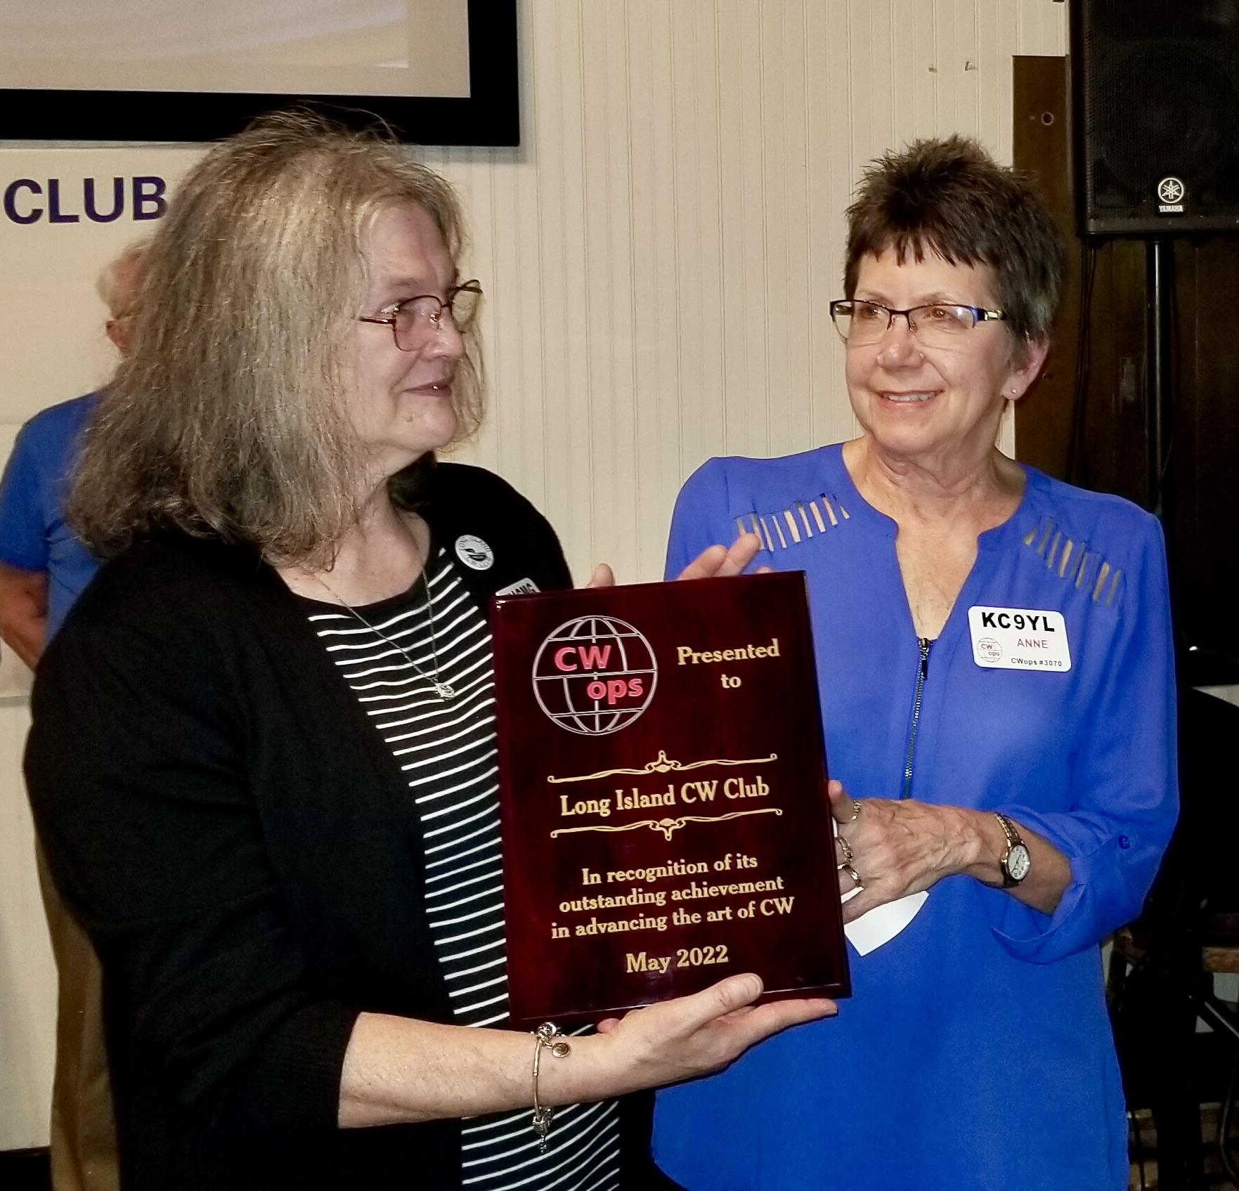
Our Membership Includes Over 300 Yl’s
Instructors
Moderators
Other leadership roles
Cathy W4CMG and Anne KC9YL accepting a prestigious award on behalf of LICW

Slide 13
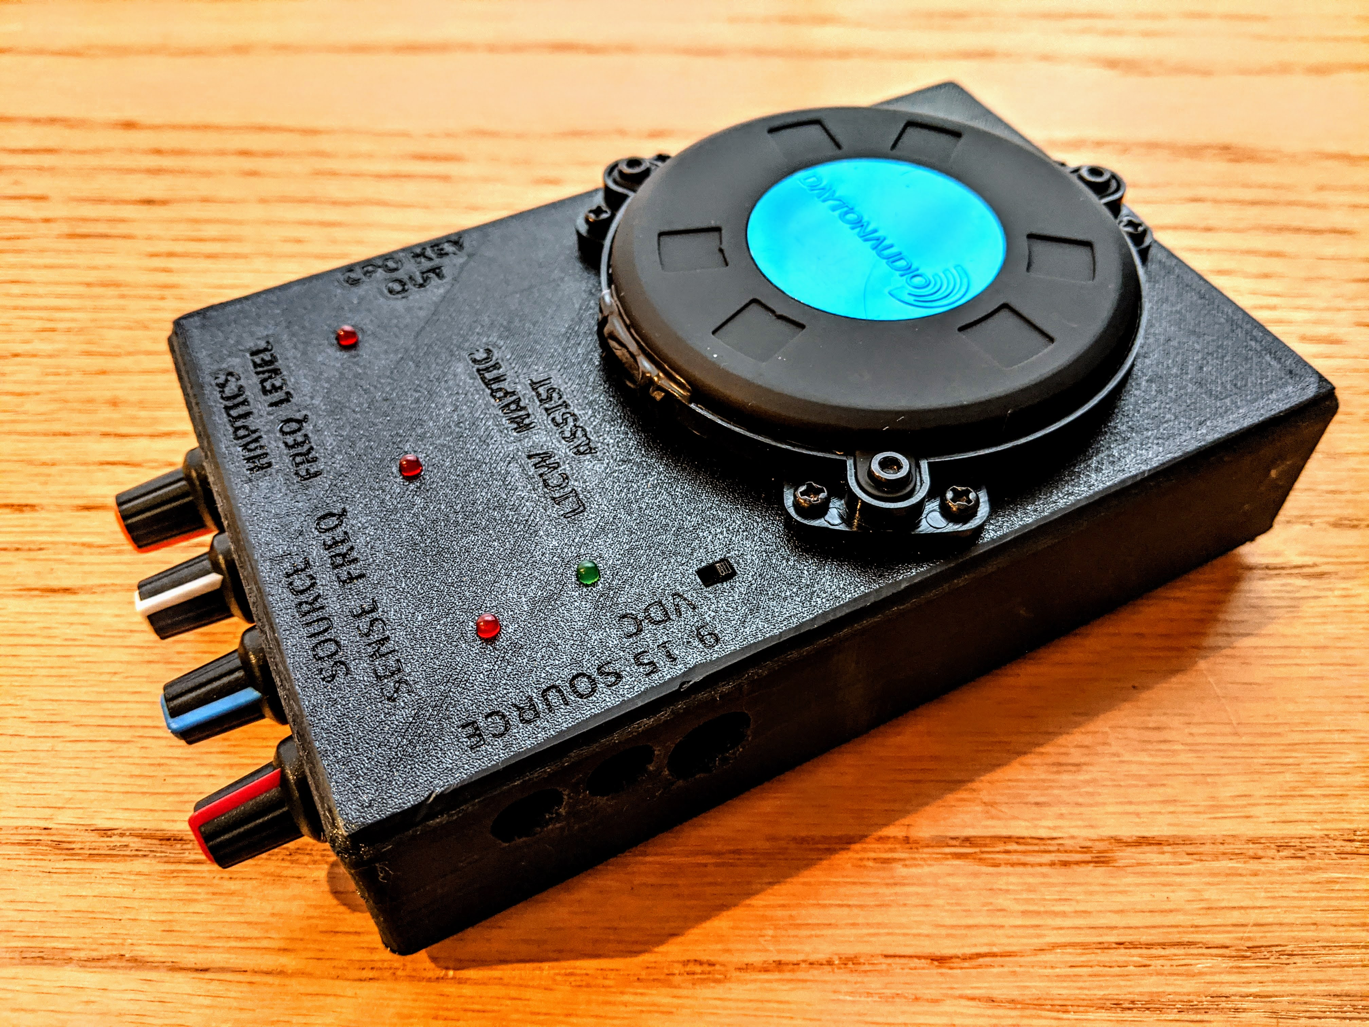
Commitment To Accessibility For People With Disabilities
Pilot Program for Autistic Adults
CW for the Hearing Impaired
CW for the Visually Impaired
Documents, Website, Practice Page
optimized for screen readers
used by the visually impaired

Slide 14
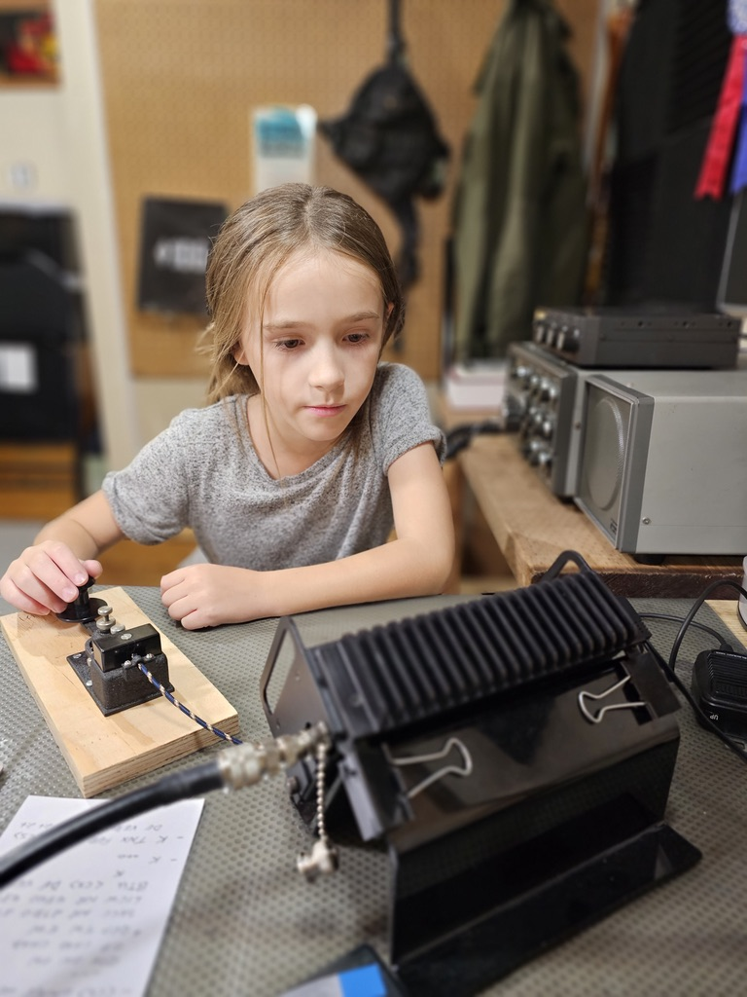
Kids Program
Developed during COVID
Small classes of 3-5 kids
One on one when needed
Ages 5 to 17
U.S., Canada, and the U.K.
Adult curriculum modified for how kids learn
Over 600 have learned CW so far

Slide 15
QUESTIONS?

