Slide 1

LICW
TEACHERS of Morse Code
Notes:
Today I would like to tell you about the Long Island CW Club and the renaissance of Morse Code

Slide 2

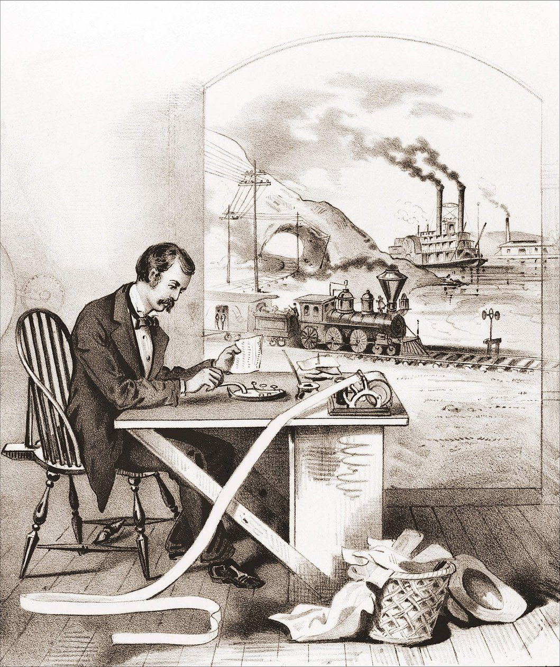
THE Renaissance of Morse Code
Morse Code was primarily used for long-distance communication
Messages sent over
  Telegraph lines
  Radio waves
  Light signals
Telegraphy: (mid-1800s to early 1900s) The original use
Maritime: Ships used it to communicate at sea
Military: Widely used during both World Wars
Aviation and Navigation: Airports and beacon identifiers
Amateur Radio: Hobby and emergency communication
Notes:
HOWARD

Slide 3

THE Renaissance of Morse Code
Morse Code requirement was removed by the FCC in 2007
Many predicted Morse Code would fade into obscurity
Instead, there’s been a remarkable resurgence
Over 100 new members join LICW each month to learn or improve
  Efficiency and Reliability
  Nostalgia and Tradition
  Emergency Preparedness
  Competitions
  Portability (SOTA/POTA)
Jim N0IPA activating Mt. Sherman 14,000’

Slide 4
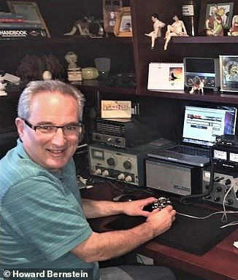

WHY learn morse code?
Very efficient method of communicating
It can be very rewarding
Amazing people, lasting friendships
A welcoming community
IT’S FUN!
DZ

Slide 5
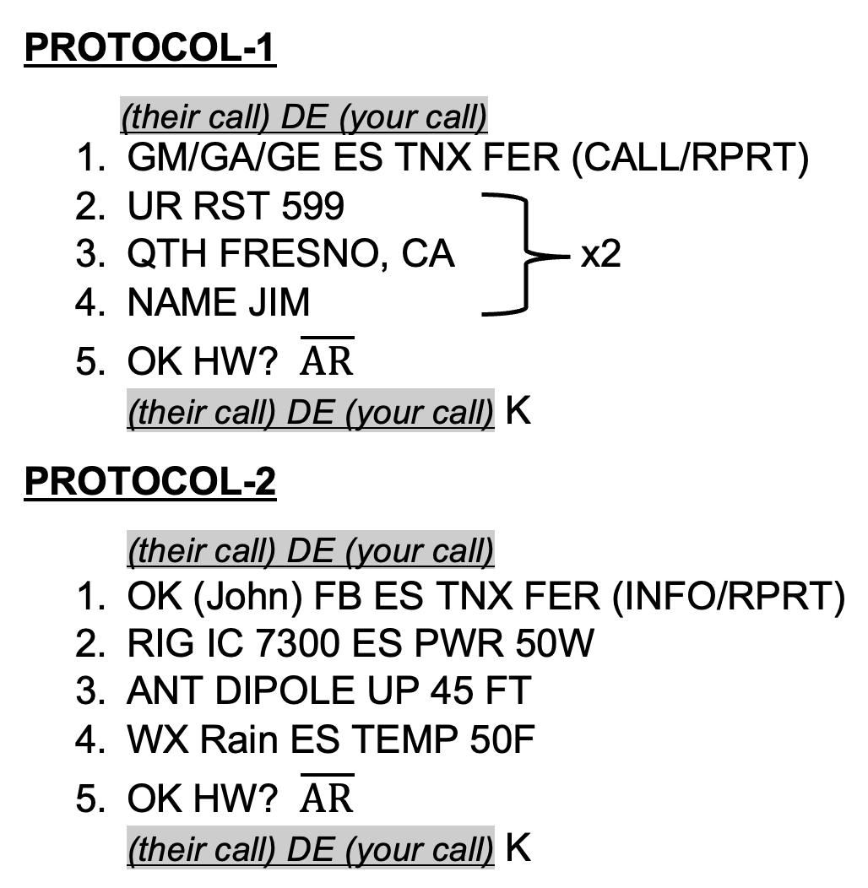

What Are We Saying in Morse Code?
Messages can be simple to conversational
The Exchange
Short vs. Long
Often just a signal report and our location
POTA, SOTA, DX …
Standard QSO (Conversational)
1st exchange: RST (signal report), QTH (location), Name
2nd exchange: Rig (radio), Antenna, Weather
Ending: A polite goodbye

Slide 6
Is It Hard to Learn Morse Code?
Commitment of time is required
Fluency
About a year of regular practice
Achievable!
Basic proficiency
Mastery
About 4 months to get on the air
Several years, but the journey is rewarding!

Slide 7

THE Licw Method
Teaching methods designed to give the average adult student the best opportunity for success in achieving proficiency in Morse code
A short video

Slide 8
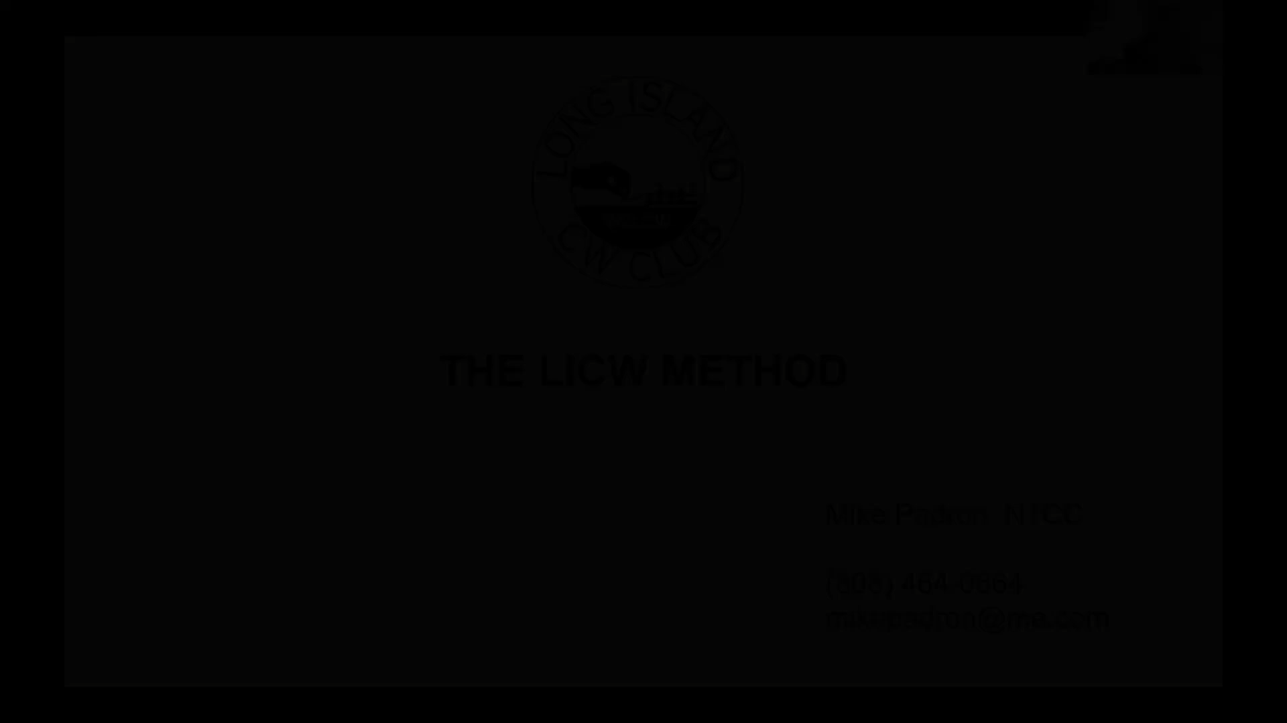
Notes:
You may speak to the next slide or play this 17-minute video:

Slide 9
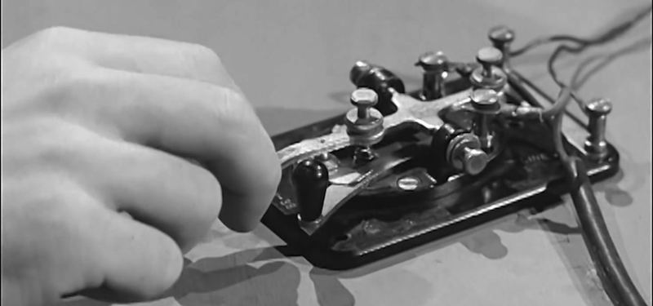
A Little Bit About Our Club
Founded in 2018
More CW operators needed / Field Day in 2017
A way to give back to the community
Goal: 50 members / Long Island area
More successful than we ever dreamed
Over 6000 members
All 50 US States
Over 60 countries around the world
Over 100 Instructors and Moderators
Over 150 Classes/Forums weekly on Zoom
English & Spanish

Slide 10
Club Resources
LICW YouTube Channel
LICW Newsletter
LICW Facebook Page
LICW This Week Podcast
LICW Discord Server (Chat, Sked)
LICW DMR: TGIF Network, Talk Group
LICW Dropbox
LICW Groups.io
LICW Morse Practice Page
LICW VBand Channel Page
LICW Challenge Page
LICW Academic Downloads

Slide 11
Beyond Core Curriculum
Intro to Club Resources
Foundational Classes
Sending Prep
Building Productive Practice Habits
Sending Fundamentals
Women's Only
Hams with Disabilities
National Traffic System
London Calling
Fun Friday
Gud Fists Sending
Essential Operating Subjects
Qualifying Runs
Code Buddy Program
CW Workshop
QSO Protocol
Digital Talk Group
Internet CW – VBand
CW Makers

Slide 12
Weekly Forums
Boat Anchors
QRP
Contesting
Technology
Antennas
DXpeditions
Historical Events
Morserino Users
Satellites
POTA and SOTA
Wild About Bugs
Elmer 101
Portable Ops
Electronic Theory

Slide 13
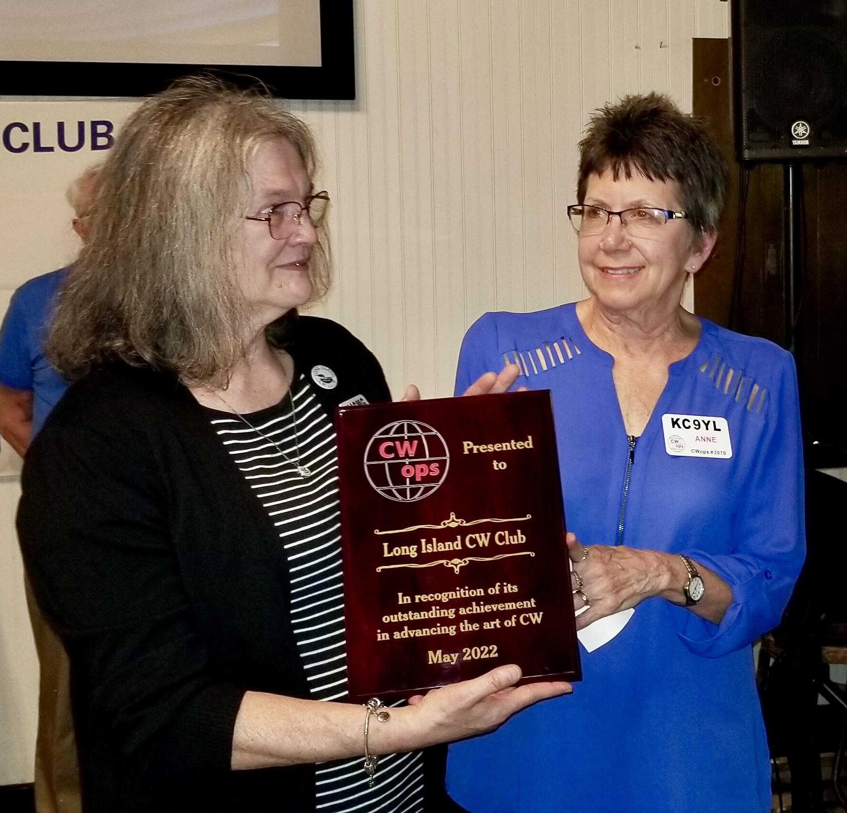
OVER 400 Yl’s
Instructors
Moderators
Other leadership roles
Cathy W4CMG & Anne KC9YL accepting award on behalf of LICW

Slide 14
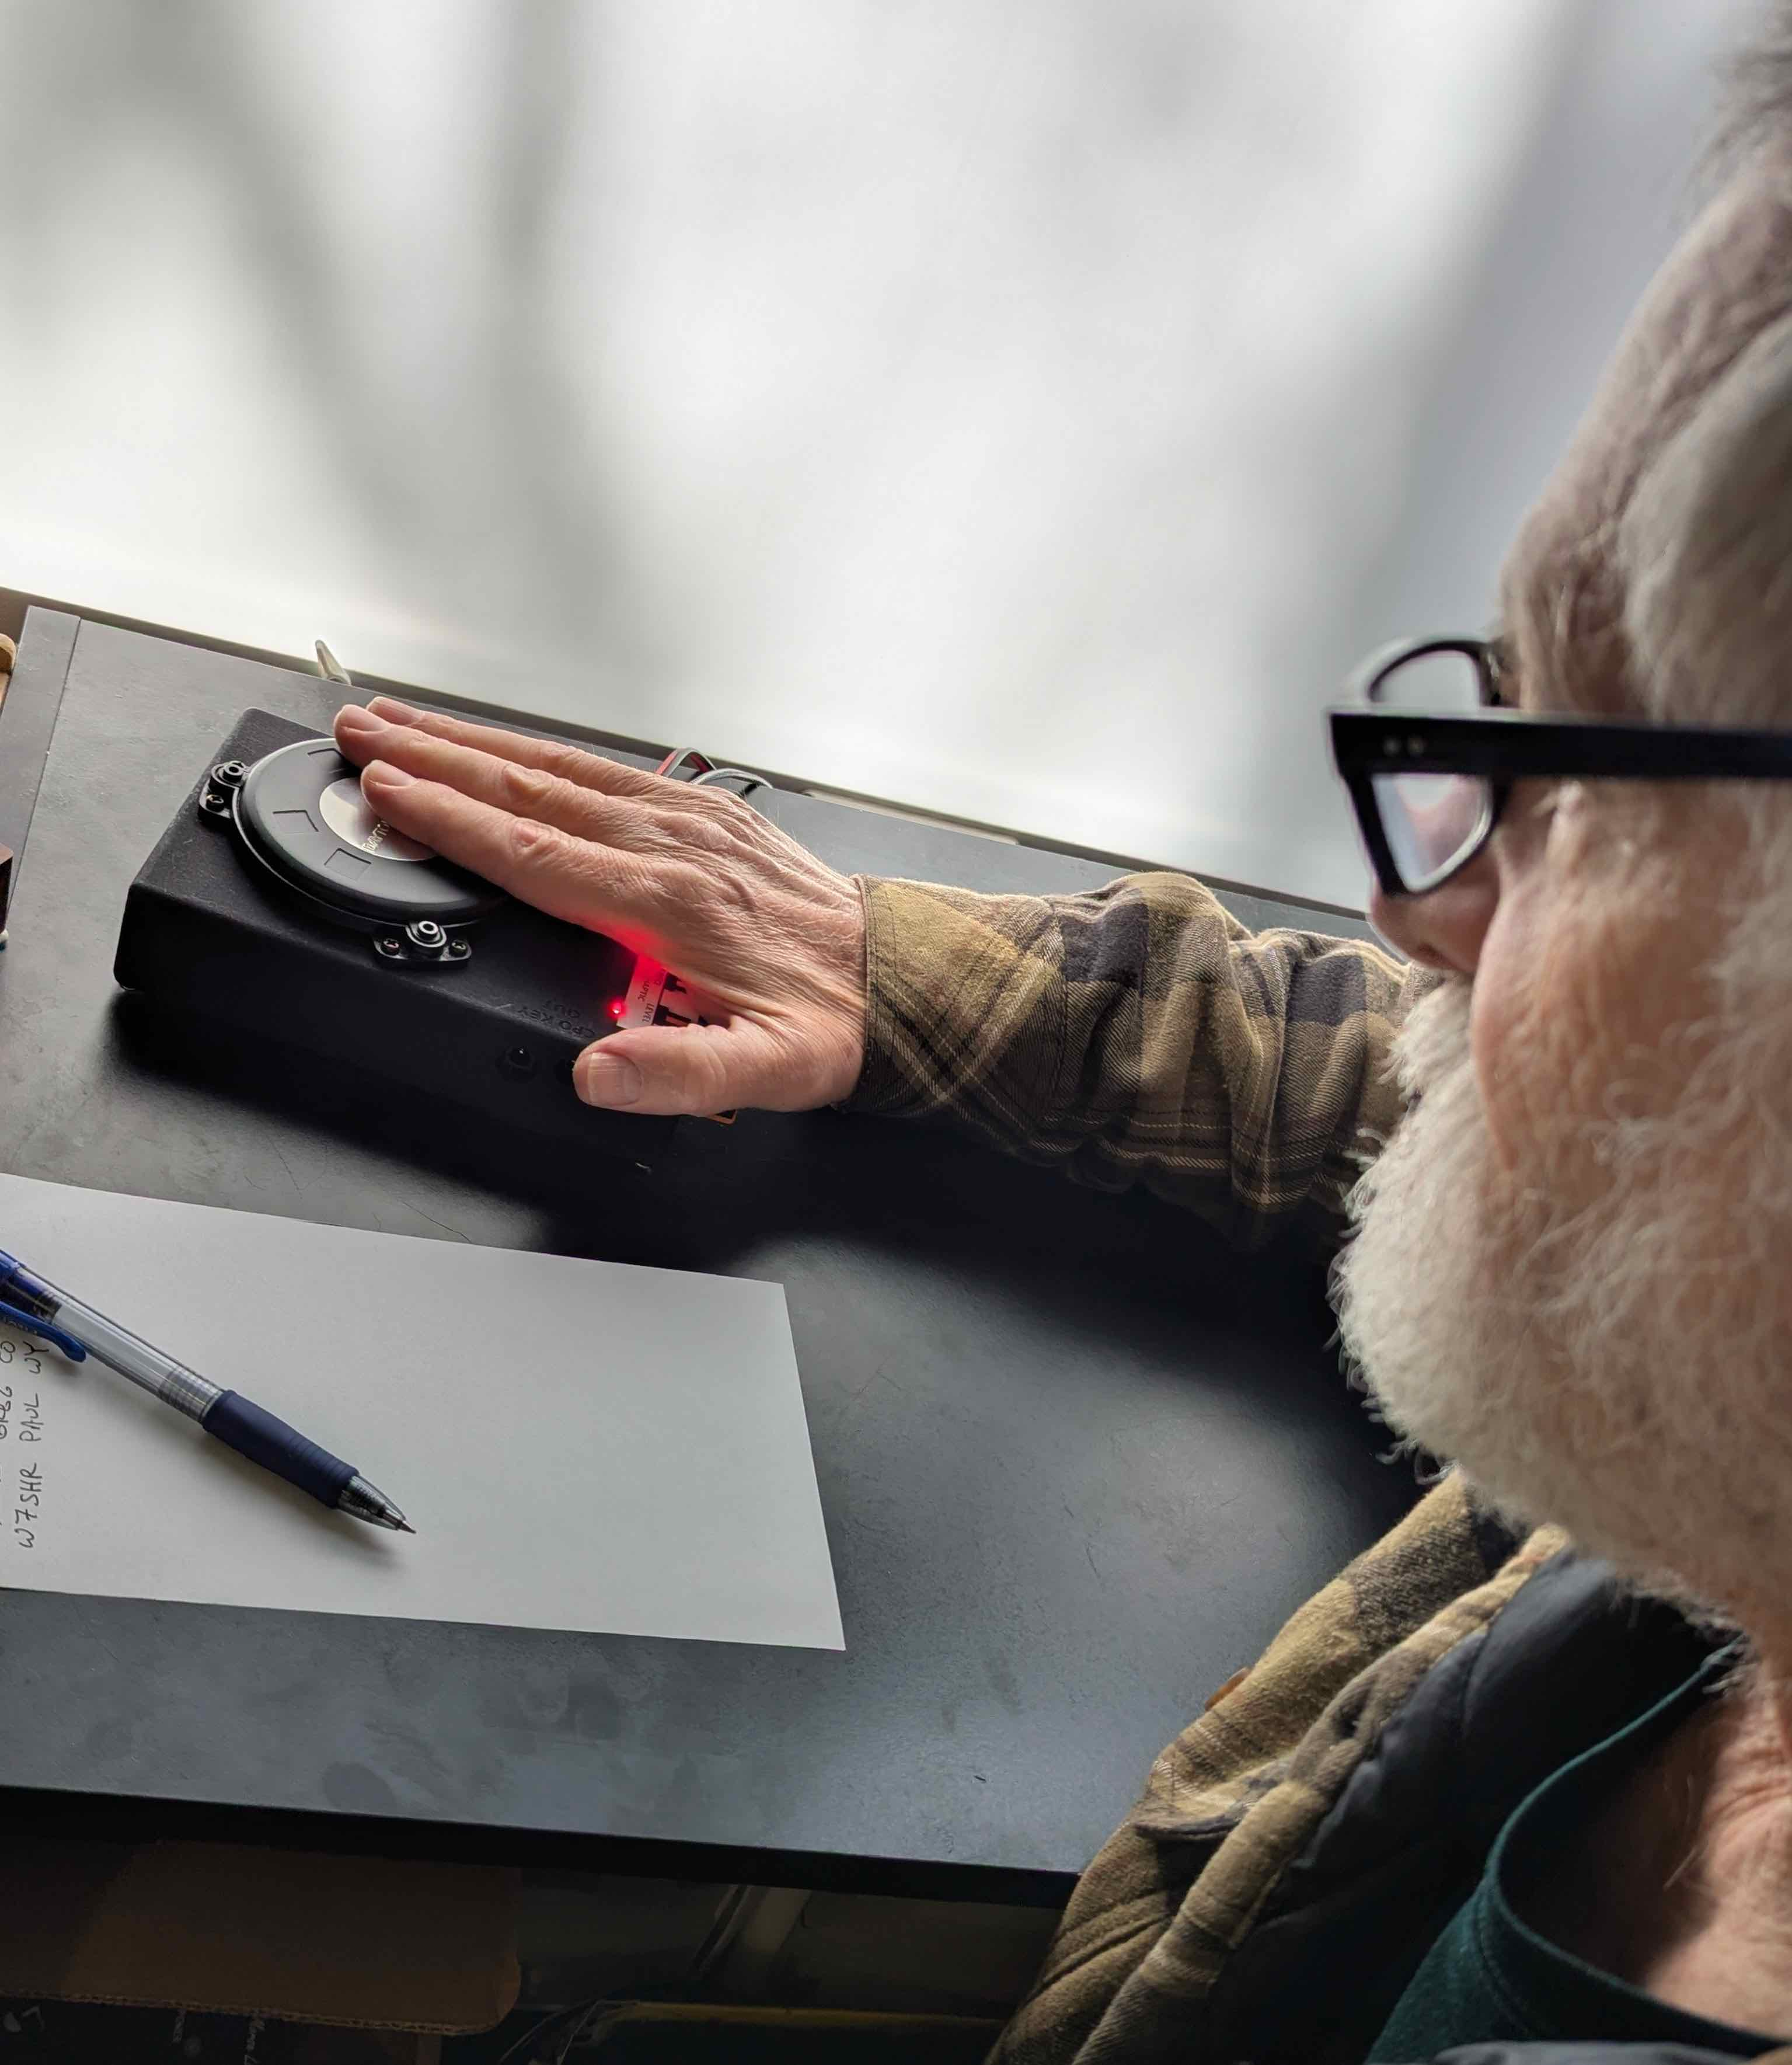
DEDICATED TO ACCESSIBILITY
CW for the Hearing Impaired – LICW Haptic Assist augmenting sound with vibration and light. Supported by the Morse Practice Page and by Kurt Zoglmann (The Morse Ninja)
CW for the Visually Impaired – LICW Docs, Website, Practice Page optimized for screen readers
Pilot Program for Autistic Adult – Mother and adult child using CW to communicate
Notes:
BOB WO6W

Slide 15
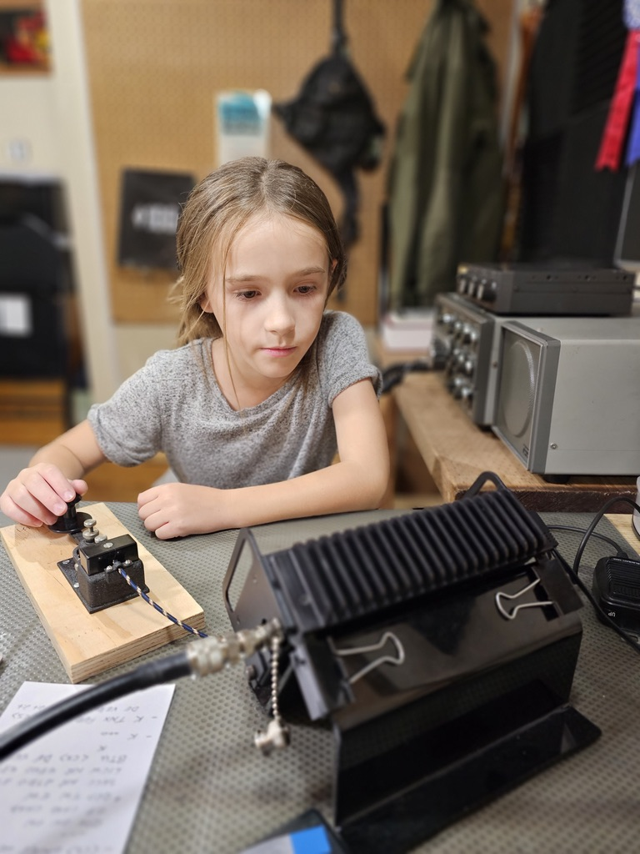
Kids Program
Developed during COVID
Ages 5 to 17
Half of our students are girls
Students from U.S., Canada, U.K., and Hungary
Adult curriculum modified for how kids learn
Over 600 kids have learned CW so far

Slide 16
QUESTIONS?

