Slide 1

National Traffic System Net Training
Week 1:
NTS Basics

Slide 2

NTS Basics
History
Structure
Traffic Flow

Slide 3
NTS Basics
Organized network of amateur radio operators who move traffic (messages)
Started in 1915 as the formal ARRL system to relay messages across the country
Goal: Relay the message is so that it arrives as it started in a timely manner- word for word, letter for letter
Primarily serves United States and Canada but does support global traffic dependent on amateur radio reciprocity agreements with other countries
Voice, Morse Code and digital modes are utilized
Four traffic types or priorities
  Emergency (life and death)
  Priority (time is of the essence)
  Welfare (health and welfare inquiries)
  Routine (day to day)

Slide 4
NTS Basics
History
Structure
Traffic Flow

Slide 5
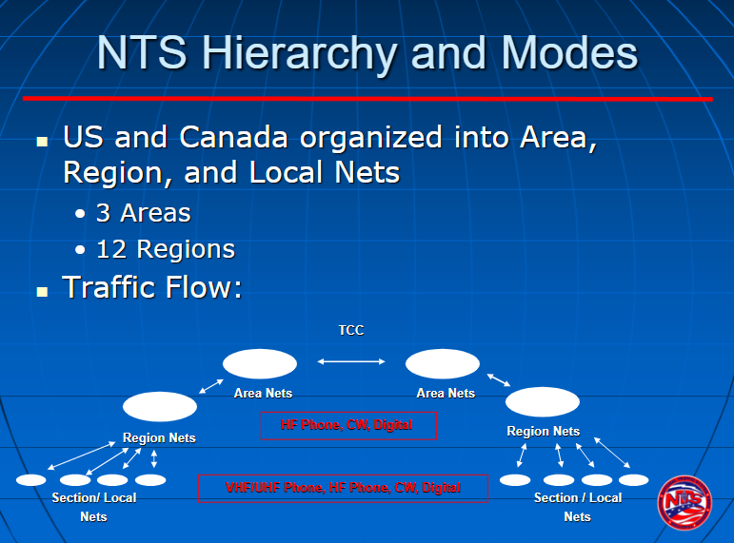
NTS Structure
Source: National Traffic System (NTS) an Introduction, Greg Szpunar N2GS

Slide 6
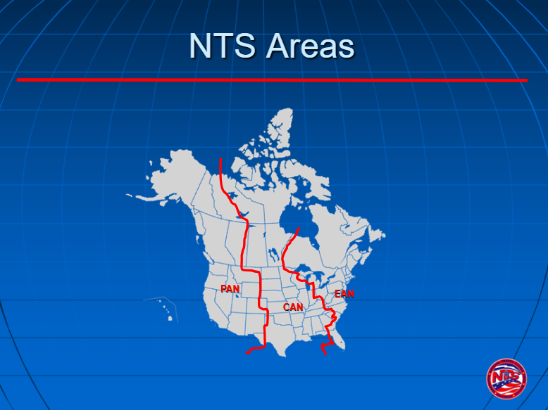
NTS Structure
Source: National Traffic System (NTS) an Introduction, Greg Szpunar N2GS

Slide 7
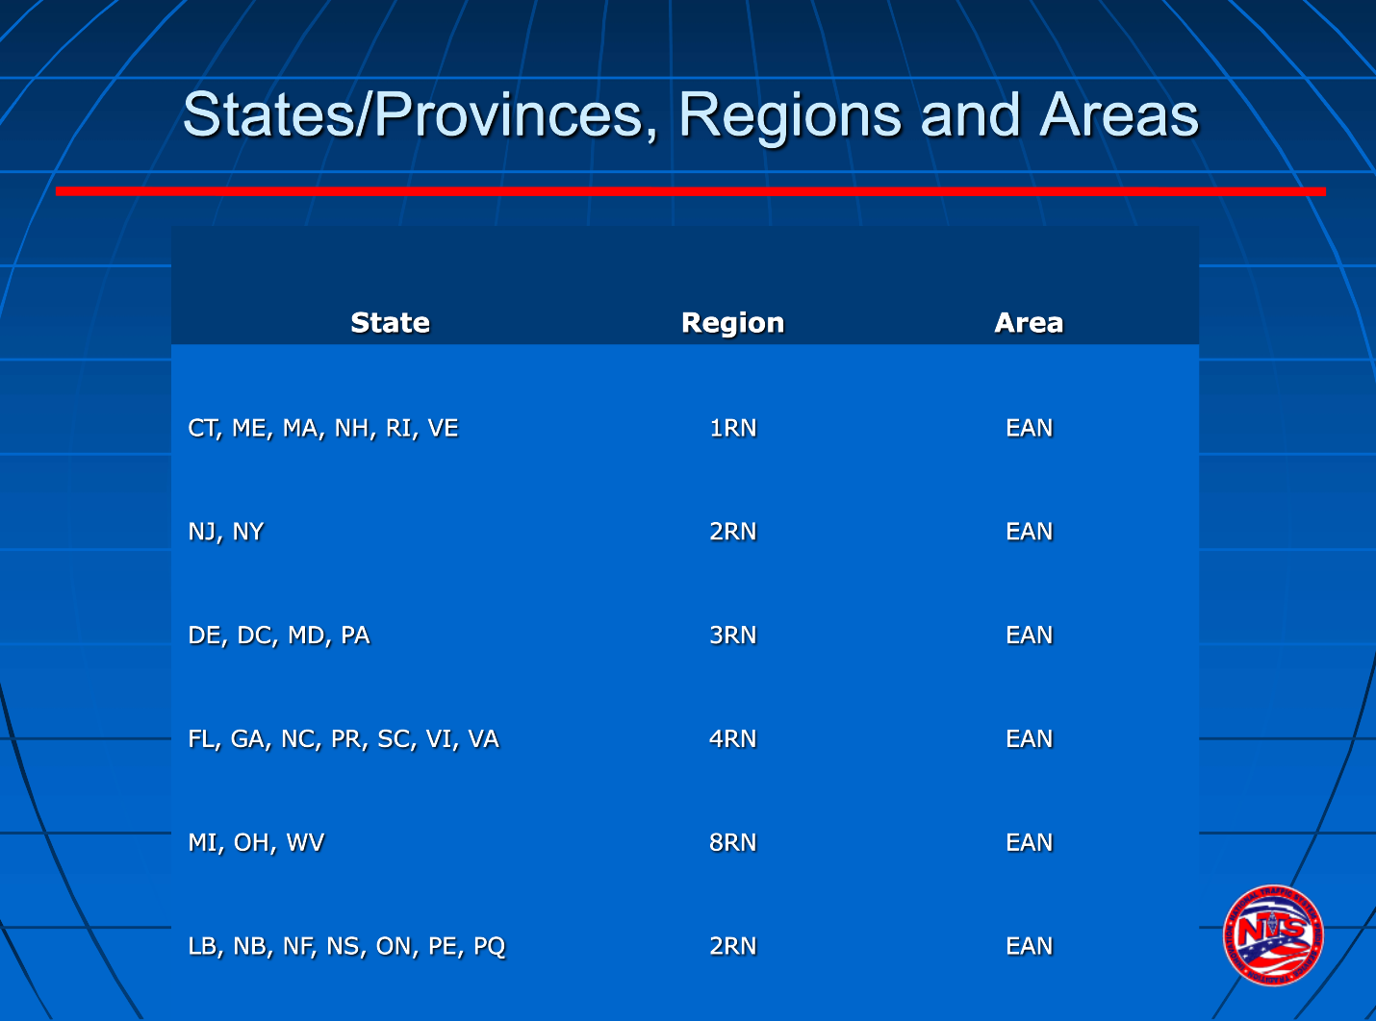
NTS Structure
Source: National Traffic System (NTS) an Introduction, Greg Szpunar N2GS

Slide 8
NTS Basics
History
Structure
Traffic Flow

Slide 9
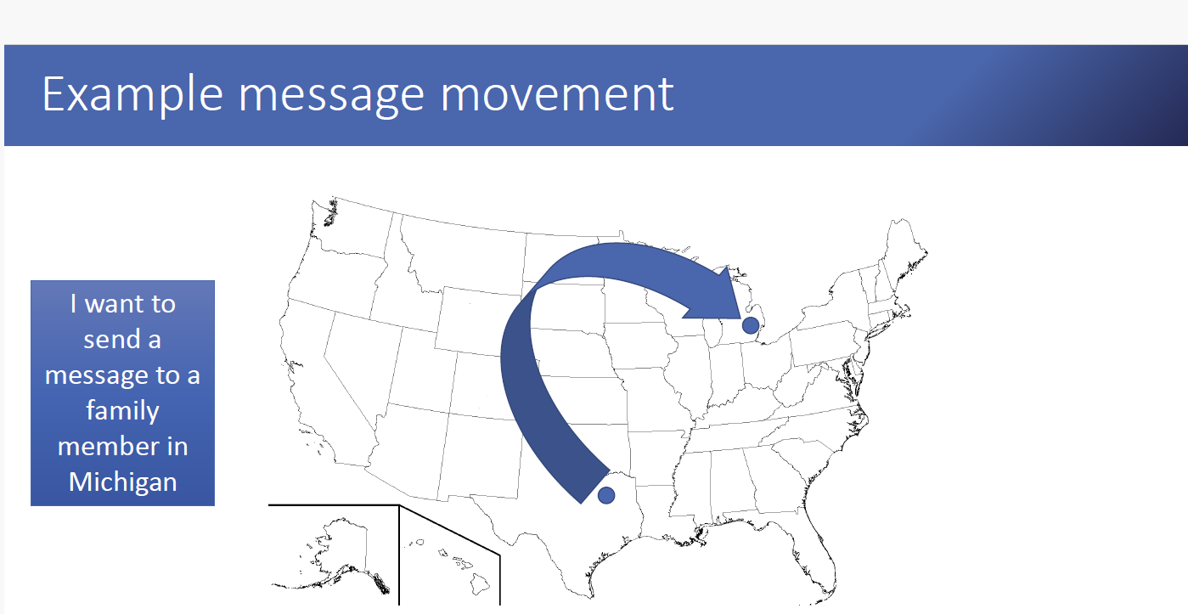
Traffic Flow
Source: 2020 MARS/NTS Exercise Traffic, Aaron Hulett K8AMH

Slide 10
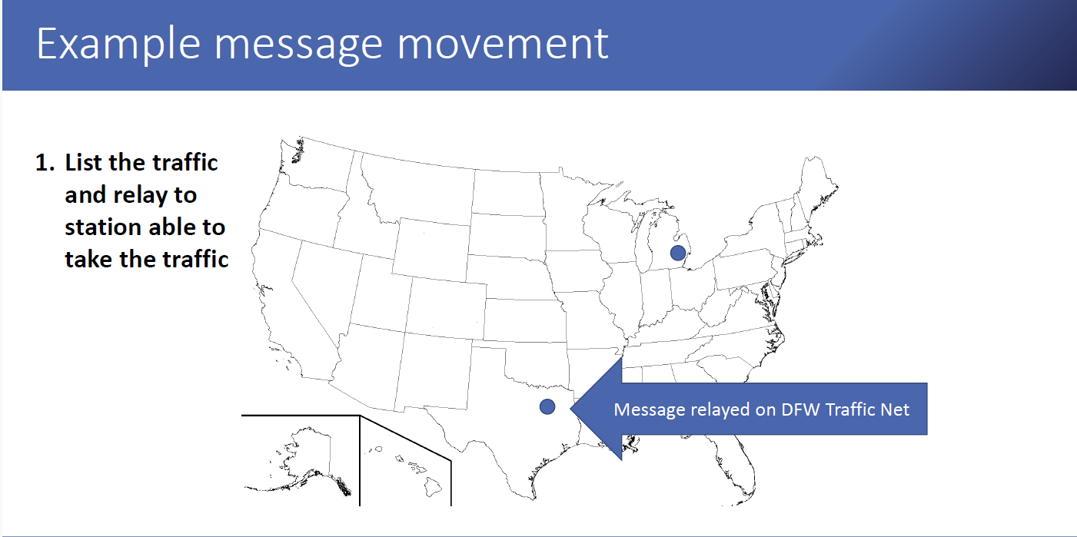
Traffic Flow
Source: 2020 MARS/NTS Exercise Traffic, Aaron Hulett K8AMH

Slide 11
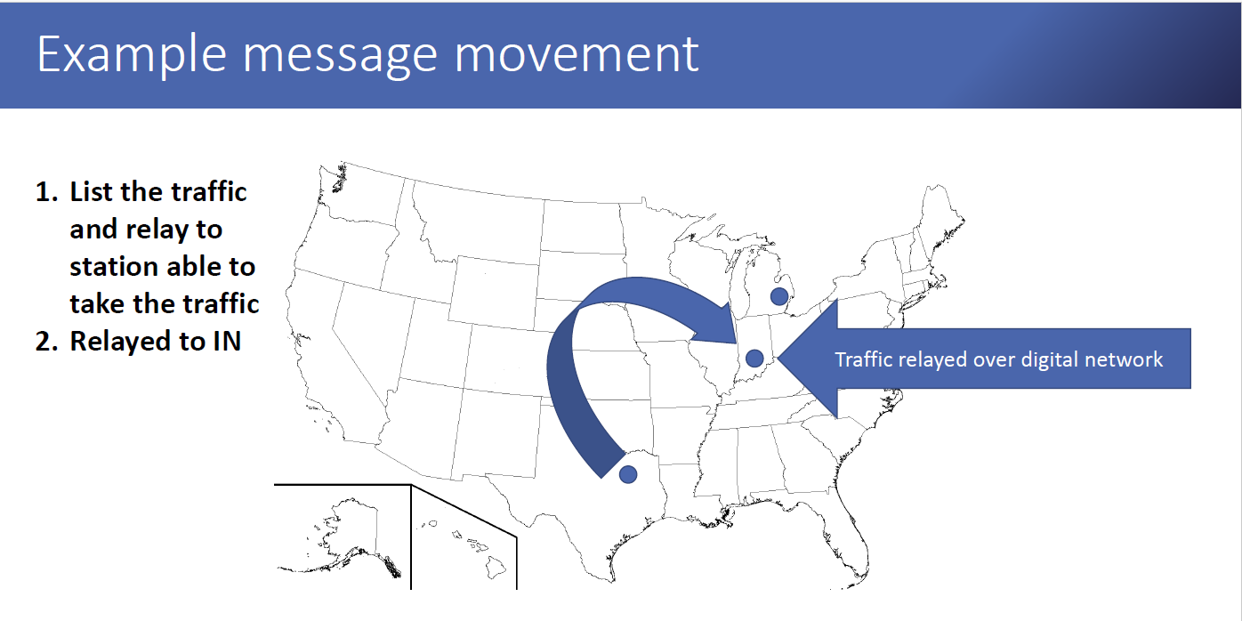
Traffic Flow
Source: 2020 MARS/NTS Exercise Traffic, Aaron Hulett K8AMH

Slide 12
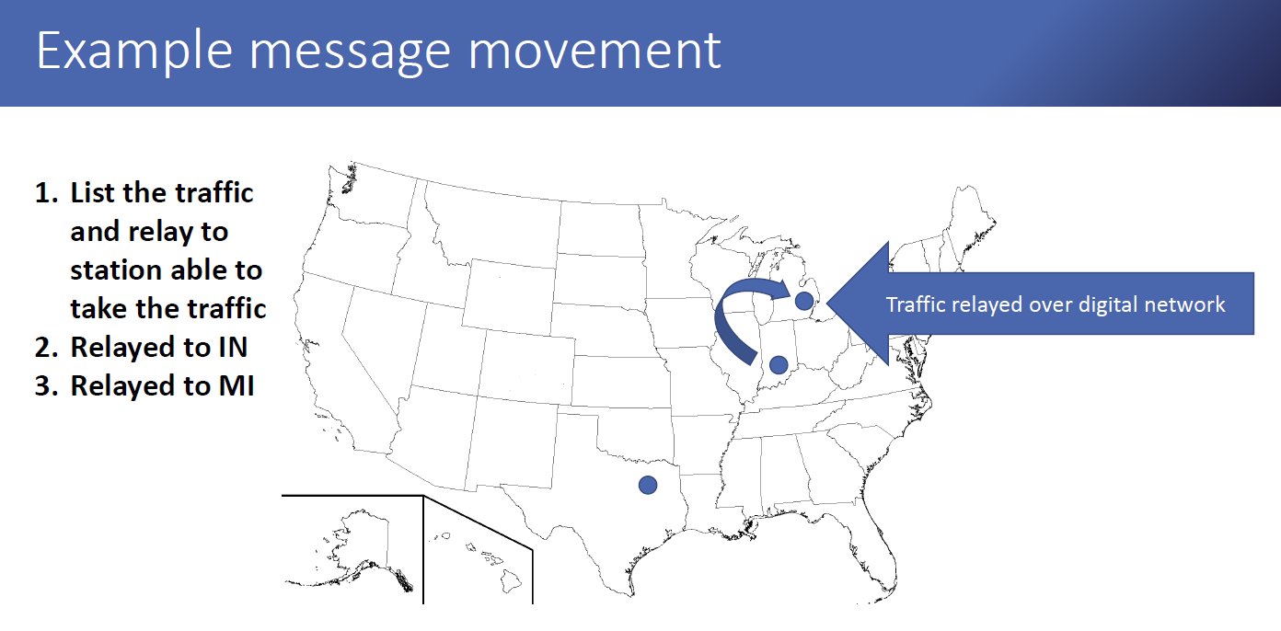
Traffic Flow
Source: 2020 MARS/NTS Exercise Traffic, Aaron Hulett K8AMH

Slide 13
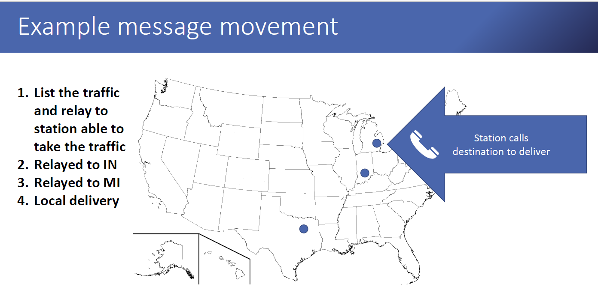
Traffic Flow
Source: 2020 MARS/NTS Exercise Traffic, Aaron Hulett K8AMH

Slide 14
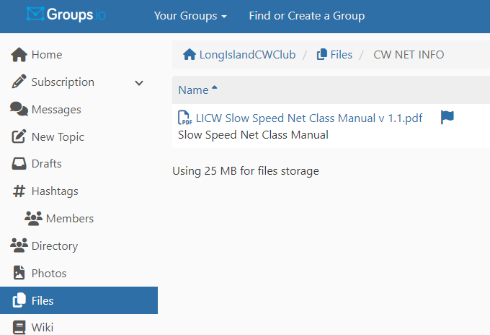
Wrap up
Questions?, Comments
Next Week- The Basics
V-Band Simulated Net
Net Class Manual

