Slide 1

National Traffic System Net Training
Week 2:
Communication Protocols

Slide 2

Communication
Protocols
ITU Phonetic Alphabet
Basic Q-Signals
CW Net QN-Signals
Prosigns & Abbreviations

Slide 3
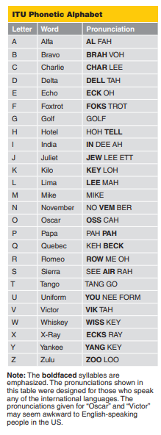
Notes
The ONLY phonetics used on traffic nets
Specific pronunciation
Must practice to become proficient
Keep a copy handy for brain freezes
ITU Phonetic Alphabet
Basic Q-Signals
CW Net QN-Signals
Prosigns & Abbreviations
From “Communicating with Other Hams”

Slide 4
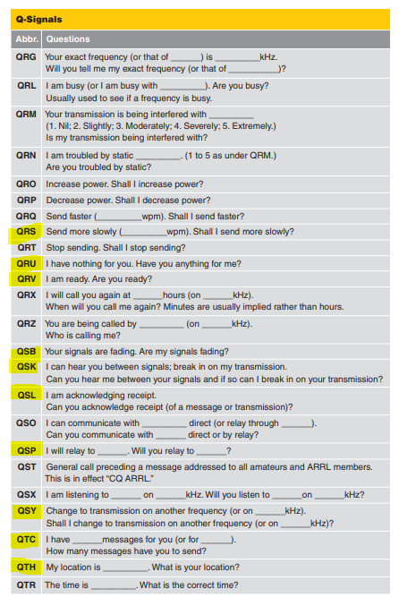
ITU Phonetic Alphabet
Basic Q-Signals
CW Net QN-Signals
Prosigns & Abbreviations
From “Communicating with Other Hams”

Slide 5
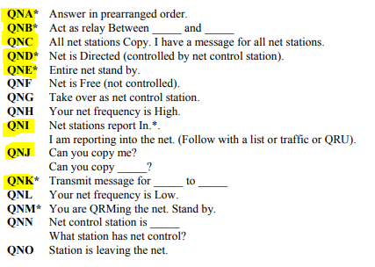
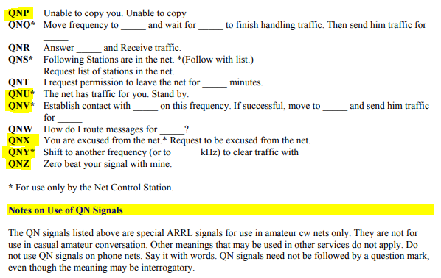
ITU Phonetic Alphabet
Basic Q-Signals
CW Net QN-Signals
From FSD-218
Prosigns & Abbreviations

Slide 6
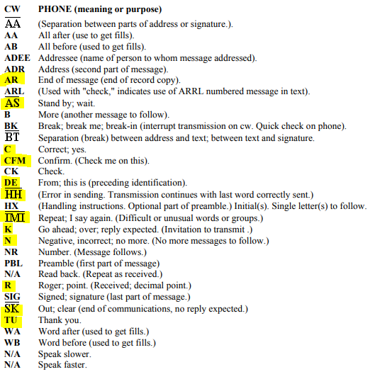
ITU Phonetic Alphabet
Basic Q-Signals
CW Net QN-Signals
Prosigns & Abbreviations
These are the ones used to check into and out of a net
From FSD-218

Slide 7
Communication
Protocols
Skill Review
ITU Phonetic Alphabet
Standard Q-Signals
CW Net Q-Signals
Prosigns and abbreviation
Resources
FSD-218
ARRL “Communicating with Other Hams”

Slide 8
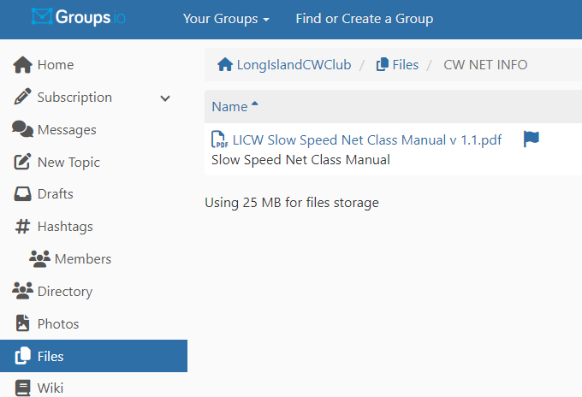
Wrap up
Questions?, Comments
Next Week- The Radiogram Form
V-Band Simulated Net
Net Class Manual

