Slide 1

National Traffic System Net Training
NTS Additional Info

Slide 2

Additional Information
Accuracy Trumps Speed
Testing the System – Cascadia Rising
Finding Nets

Slide 3
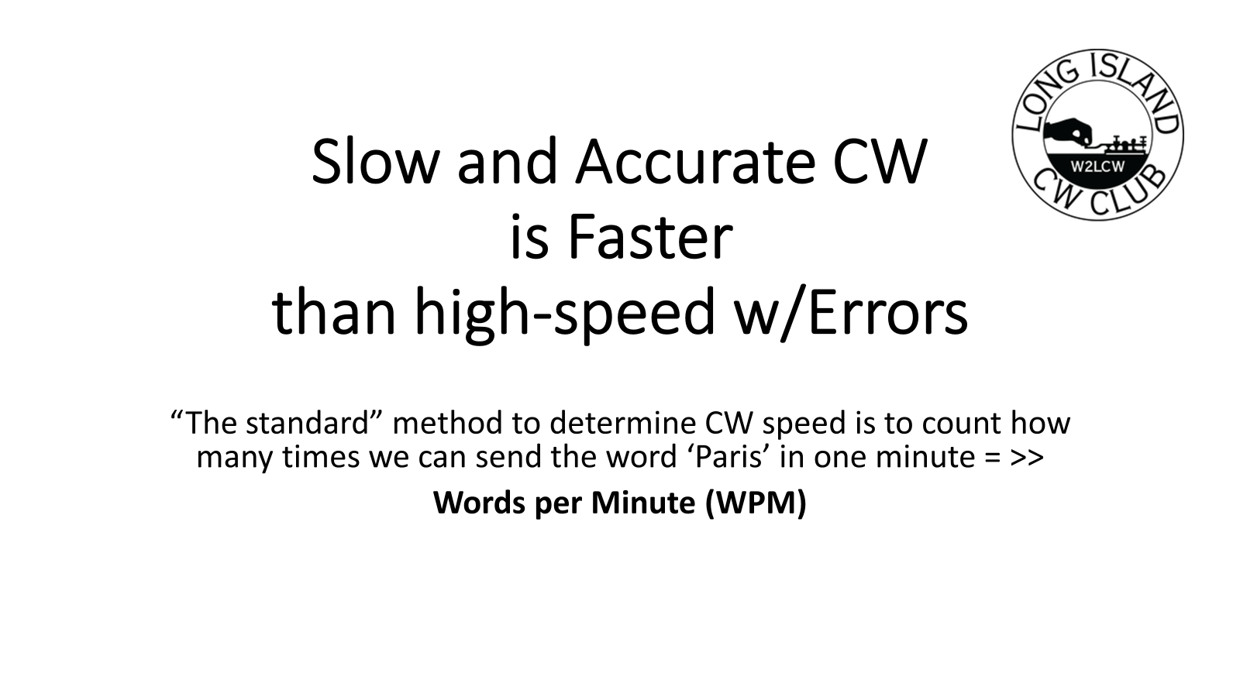
Accuracy
Trumps
Speed

Slide 4
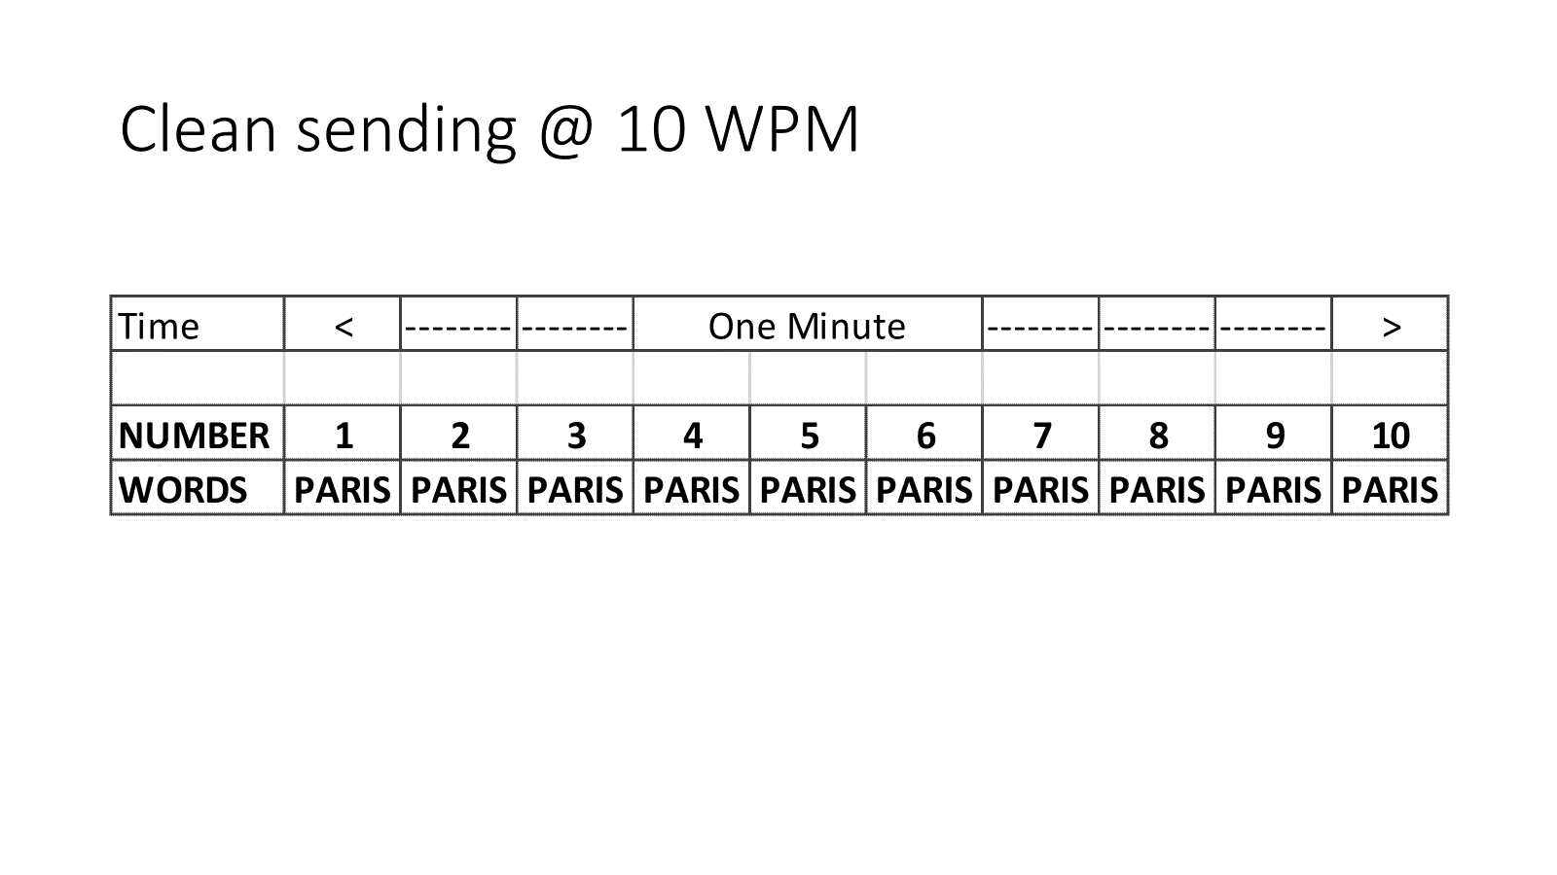
Accuracy
Trumps
Speed

Slide 5
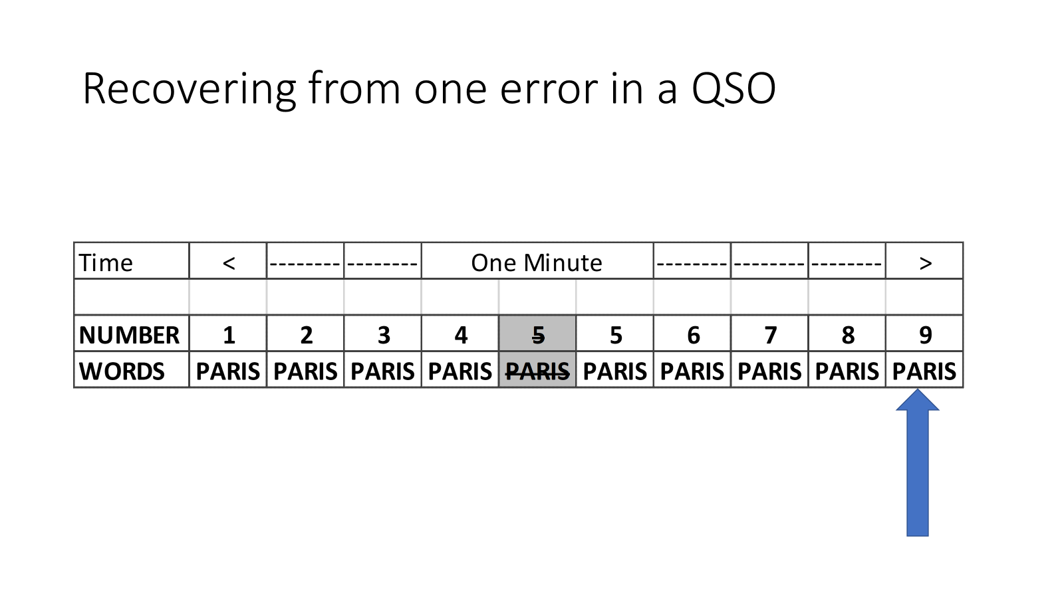
Accuracy
Trumps
Speed

Slide 6
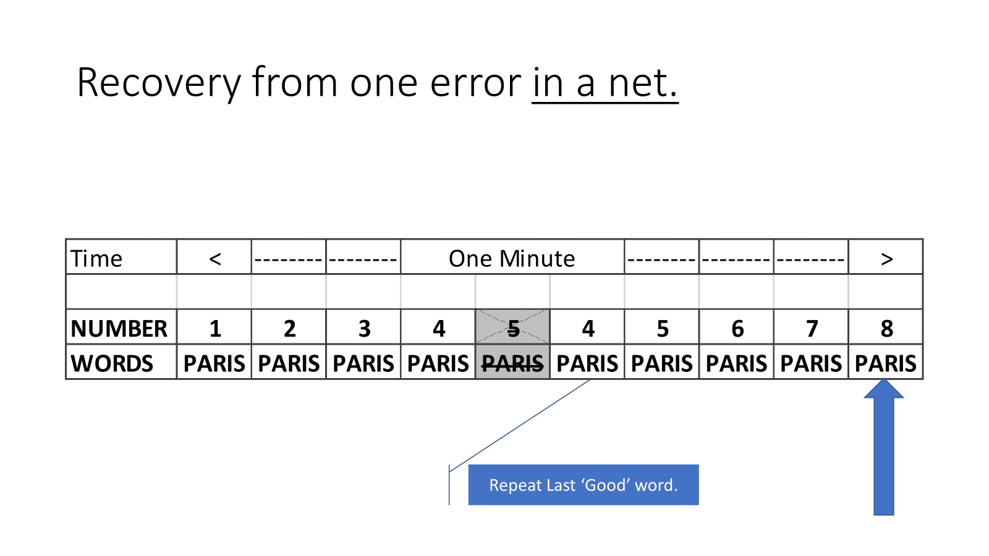
Accuracy
Trumps
Speed

Slide 7
Additional Information
Accuracy Trumps Speed
Testing the System – Cascadia Rising
Finding Nets

Slide 8
Testing the System with Cascadia Rising
Summary
2016
9.0 Earthquake of the coast of Oregon
Tsunami disaster along Pacific Northwest Coastline
Blackout of all regular communication systems
Resource
Cascadia Rising Final Report

Slide 9
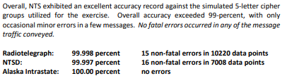
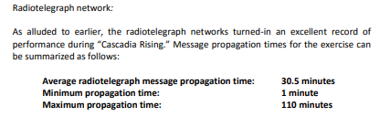
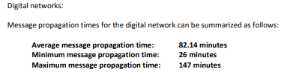
Cascadia Rising Results
Propagation did not allow for voice relay of messages
Radiotelegraph (CW) got the messages to the destination both faster and (slightly) more accurate than digital.

Slide 10
Additional Information
Accuracy Trumps Speed
Testing the System – Cascadia Rising
Finding Nets

Slide 11
Finding Nets
Summary
Traffic Nets at the Section and Area tend to be on 80m
Local nets are generally on VFH/UHF repeaters
Net listings are notoriously out of date
Resources
Section Traffic Manager
ARRL Net Search
RRI Net Listing

Slide 12
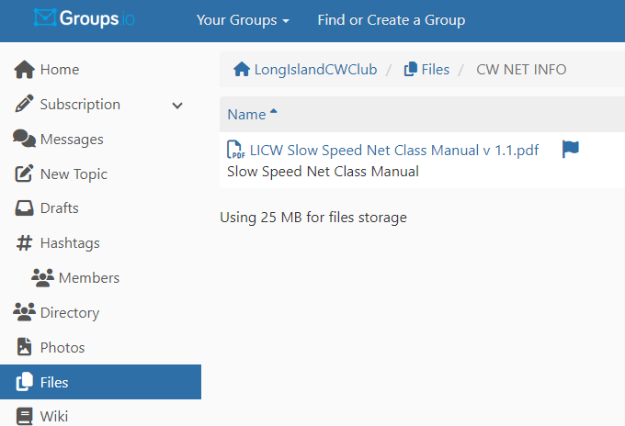
Wrap up
Questions?, Comments
Next Week- The Radiogram Form
V-Band Simulated Net
Net Class Manual

