Slide 1

National Traffic System Net Training
Week 3:
The Radiogram

Slide 2

The Radiogram
Summary
Standardized format
Receiving station knows what to expect
Built in error detection
Resources
Printable Radiogram Form
FSD-218

Slide 3
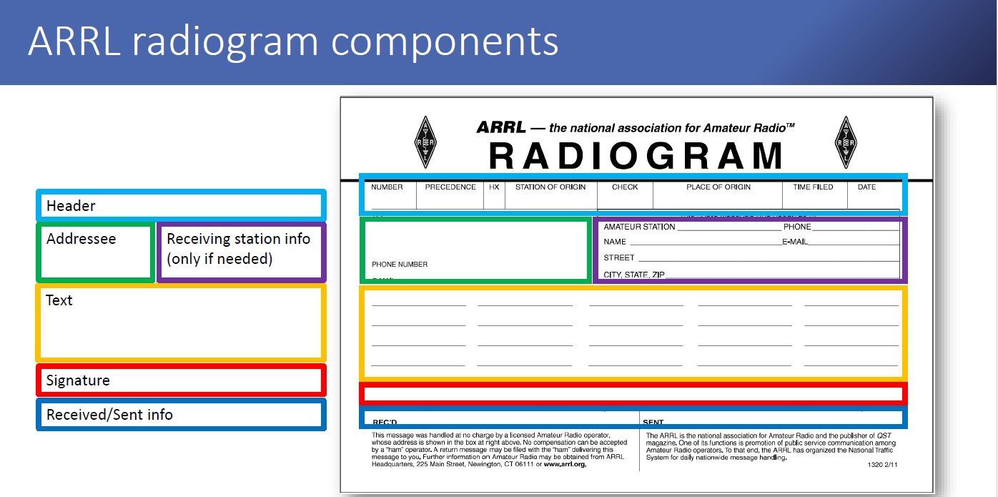
The Radiogram
Overview
Source: 2020 MARS/NTS Exercise Traffic, Aaron Hulett K8AMH

Slide 4
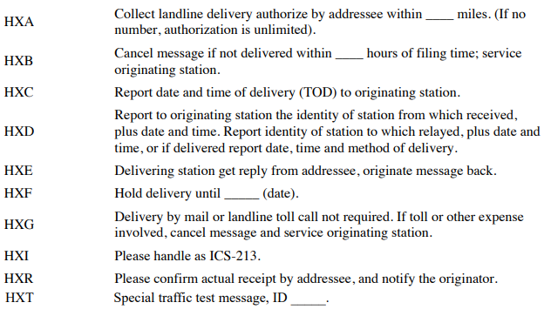
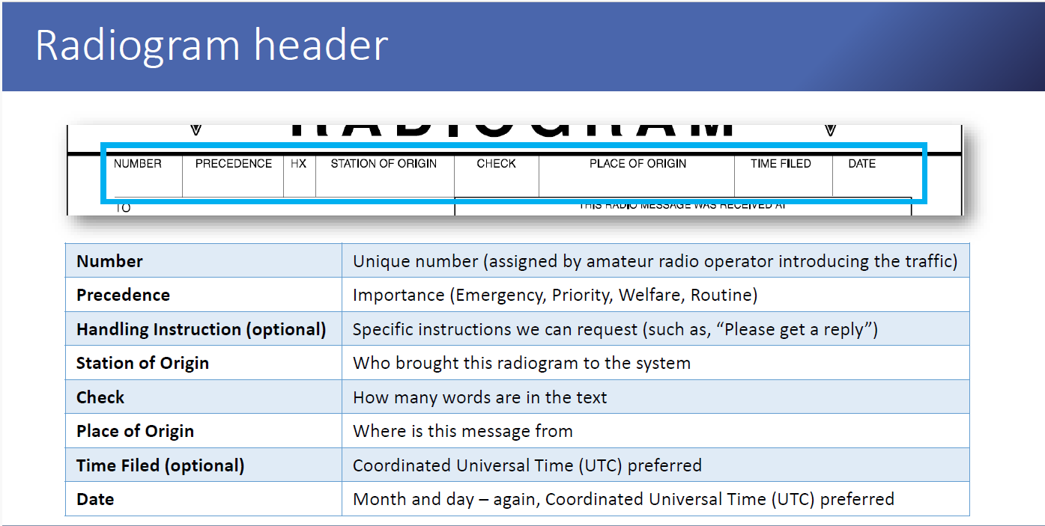
The Radiogram
Preamble
From NTS 2.0
Click here for
Handling Instructions
Source: 2020 MARS/NTS Exercise Traffic, Aaron Hulett K8AMH
Notes:
Handling instructions is a pop-up

Slide 5
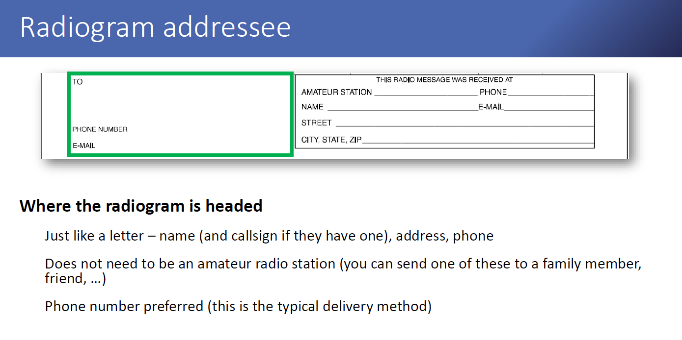
The Radiogram
Address
Source: 2020 MARS/NTS Exercise Traffic, Aaron Hulett K8AMH

Slide 6
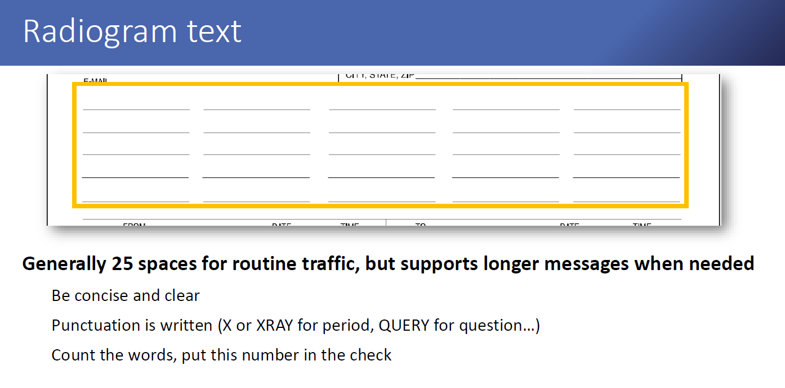
The Radiogram
Text
Source: 2020 MARS/NTS Exercise Traffic, Aaron Hulett K8AMH

Slide 7
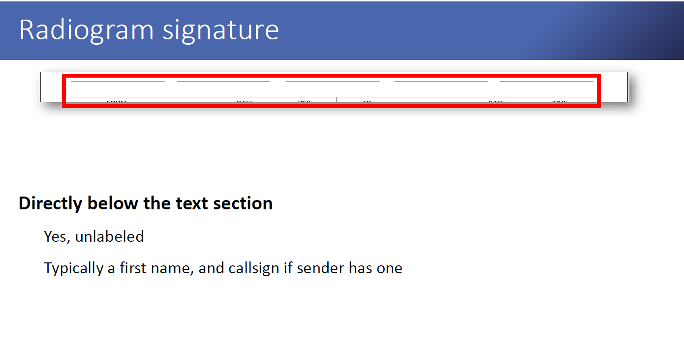
The Radiogram
Signature
Source: 2020 MARS/NTS Exercise Traffic, Aaron Hulett K8AMH

Slide 8
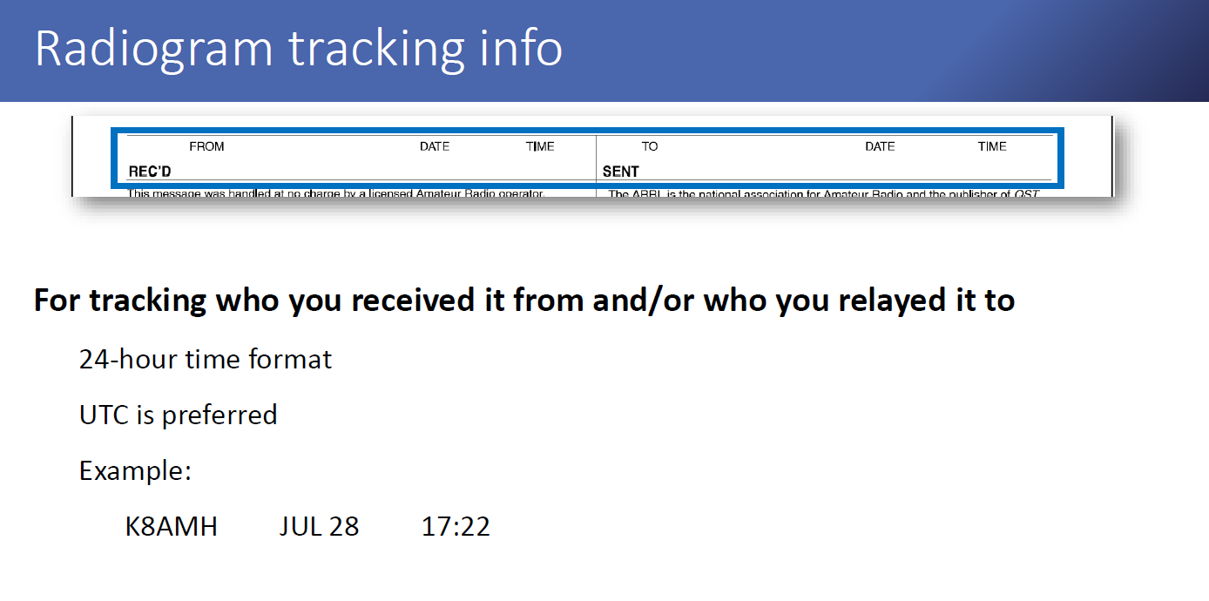
The Radiogram
Tracking Info
Source: 2020 MARS/NTS Exercise Traffic, Aaron Hulett K8AMH

Slide 9
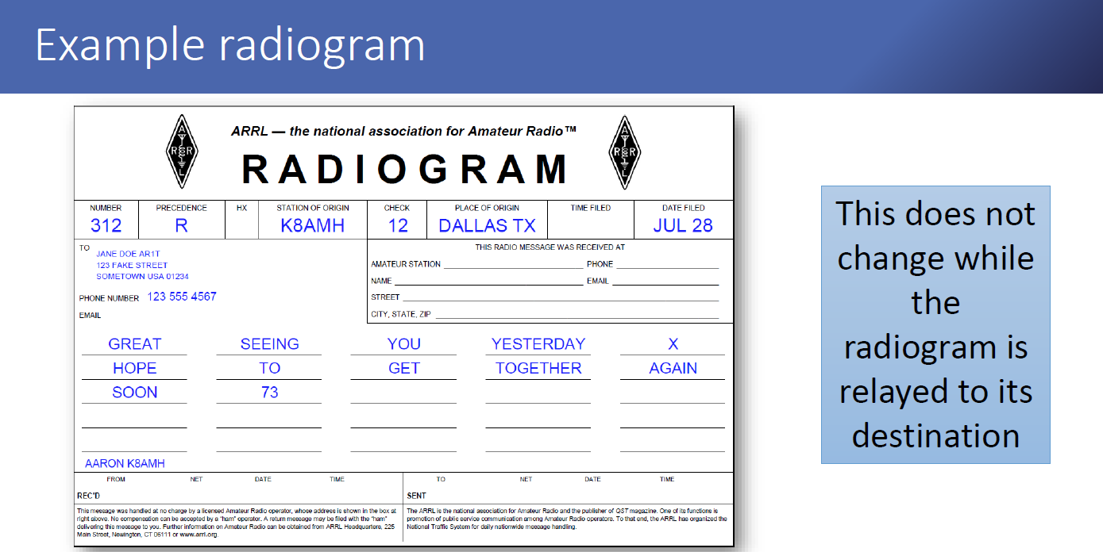
The Radiogram
An Example
Source: 2020 MARS/NTS Exercise Traffic, Aaron Hulett K8AMH

Slide 10
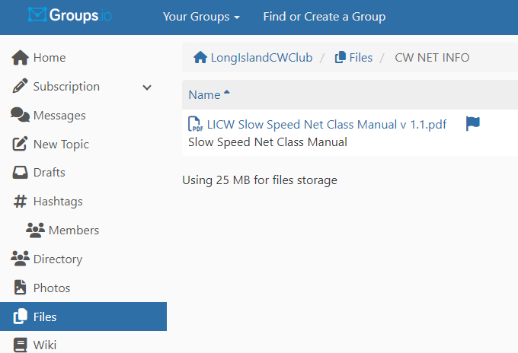
Wrap up
Questions?, Comments
Next Week- Traffic is Traffic
V-Band Simulated Net
Net Class Manual

