Slide 1

National Traffic System Net Training
Week 4:
Traffic is Traffic

Slide 2

Traffic is Traffic
Modes
Phone
CW
Digital

Slide 3
Modes
The Three Modes
Phone (Voice) – HF or V/UHF
CW – HF
Digital – HF or V/UHF
The modes are interoperable: the Radiogram is unchanged!

Slide 4
Traffic is Traffic
Modes
Phone
CW
Digital

Slide 5
Phone
Protocol
ITU Phonetic Alphabet
“I Spell”
“Mixed Group”
“Figures”
“Phone Figures”
“Initials”
Resources
FSD-218
ARRL “Communicating with Other Hams”

Slide 6
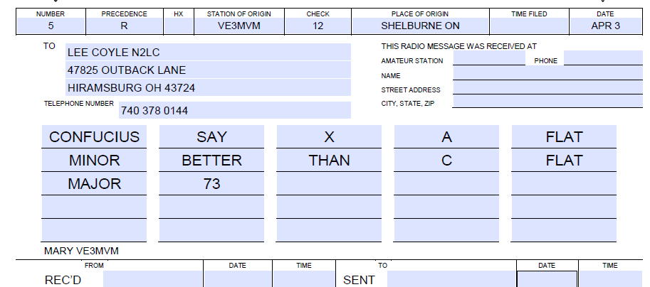
Phone
Example

Slide 7
Traffic is Traffic
Modes
Phone
CW
Digital

Slide 8
CW - Review
N
C
B#
QNX
Q-sigs, Abbreviation, Prosigns
QRV
QSL
-AA-
-AR-
-BT-
Resources
FSD-218
ARRL “Communicating with Other Hams”

Slide 9
CW
Example

Slide 10
Traffic is Traffic
Modes
Phone
CW
Digital

Slide 11
Digital
Protocol
Uses a text only version of the Radiogram
WinLink – Radiogram Form. Uses the Internet to WinLink nodes. Outgoing traffic only
MBO – Uses RF Only, VARA protocol. Can be used for outgoing and incoming traffic
NOTE: DO NOT MIX BOTH WINLINK AND MBO MESSAGES IN YOUR OUTBOX AND CONNECT TO EITHER TYPE OF NODE
Resources
WinLink
NTS-Digital.net

Slide 12
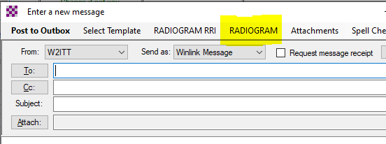
WinLink
WinLink uses RF to WinLink nodes and then the Internet to an MBO
Select “RADIOGRAM” on a new message
Resources
WinLink

Slide 13
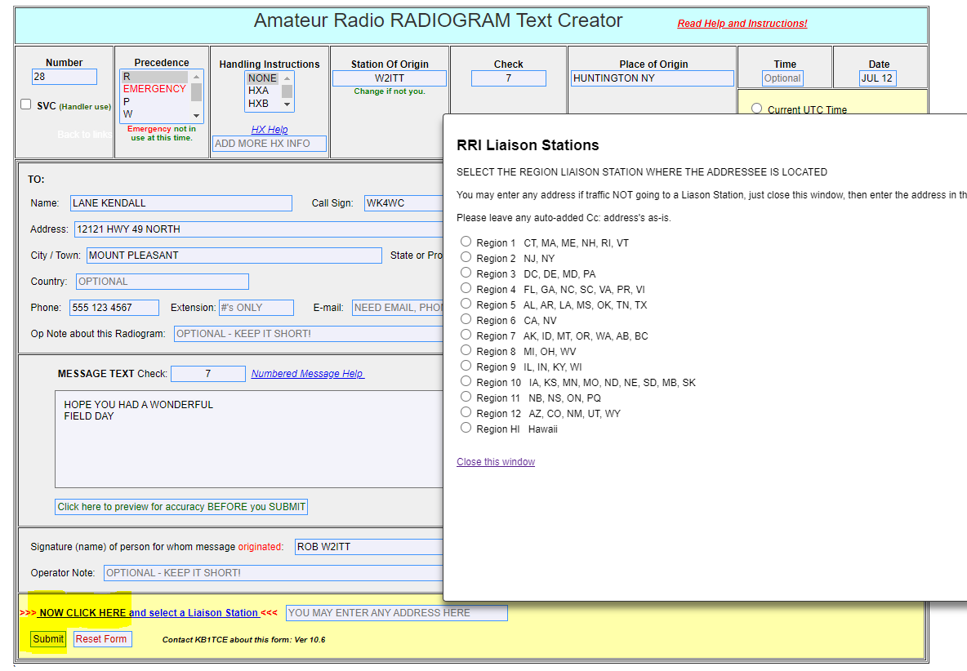
WinLink
A browser window opens with a Radiogram Form. Fill it out, select a Liaison Station and click Submit

Slide 14
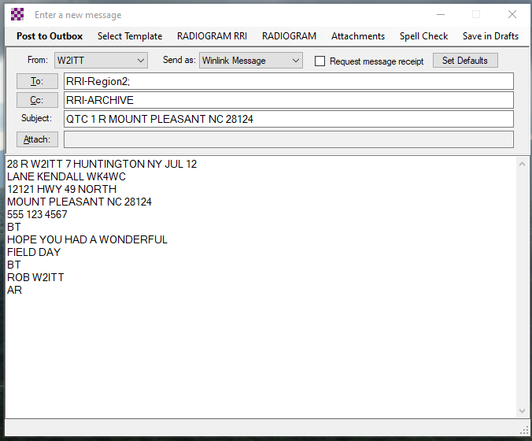
WinLink
The message is transferred to the WinLink message properly formatted and is ready to post to your outbox

Slide 15
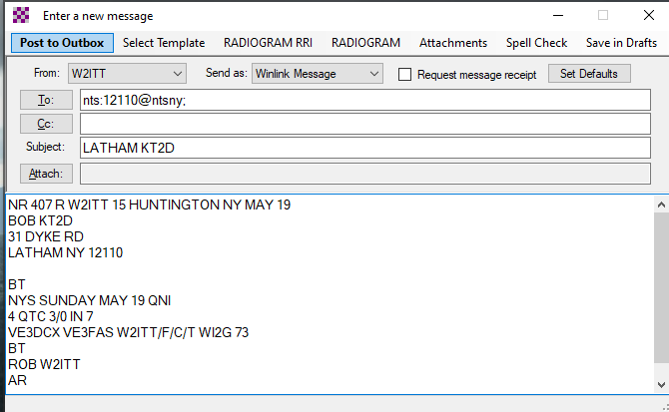
Mailbox Operation
Message ready to be sent to an MBO

Slide 16
Mailbox Operation
Summary
Address and Subject must be formatted correctly
The radiogram must be manually formatted correctly
Uses the VARA digital protocol
You must be set up in advance to receive traffic
Resources
WinLink
How to setup VARA to Access DTN Hubs
Western Area Guidelines and Stations

Slide 17
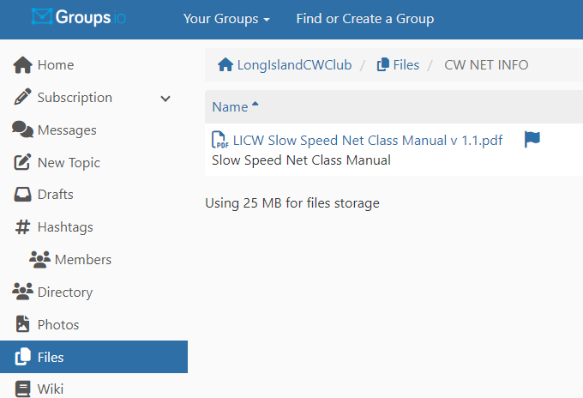
Wrap up
Questions?, Comments
Next Week- Introduction to CW Traffic Nets
V-Band Simulated Net
Net Class Manual

