Slide 1

National Traffic System Net Training
Week 5:
Checking into a CW Traffic Net

Slide 2

Checking Into a CW Traffic Net
Q-Signal Review
Check in/out procedure
CSN Recording

Slide 3
Q-Signal Review
HR
QRV
QSK
QSL
R
QNX
-SK-
QNF
-AS-
Q-Signals, Prosigns, Abbreviations
QRL
QND
QNZ
QNA
QNI
QRU
QTC
-AR-
Resource
FSD-218

Slide 4
Checking Into a CW Traffic Net
Q-Signal Review
Check in/out procedure
CSN Recording

Slide 5
Check-in Procedure
Checking into a net
Net Control sends QNI K as an invitation for general check ins
To check in, send a single character, usually the first letter in your suffix
The NCS will send the letter of the station they want to QNI next
When the NCS sends your letter, check in by sending DE –call- GE -NCS name- QRU –AR- if you have no traffic
The NCS will acknowledge your QNI

Slide 6
Check-out Procedure
Checking out of a net
Net Control sends your call
Respond with R
The minimum response is something like TU LANE 73 DE W2ITT –SK-
The NCS will send something like W2ITT TU ROB FER QNI NW QNX 73 K
NOTE: once checked into a net don’t leave until the NCS checks you out

Slide 7
Checking Into a CW Traffic Net
Q-Signal Review
Check in/out procedure
CSN Recording

Slide 8
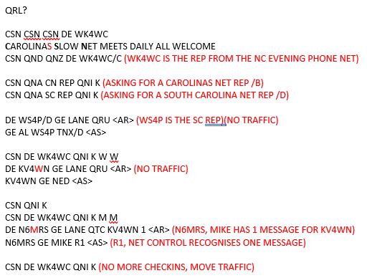

CSN Recording Preamble & Check in
Click for recording

Slide 9
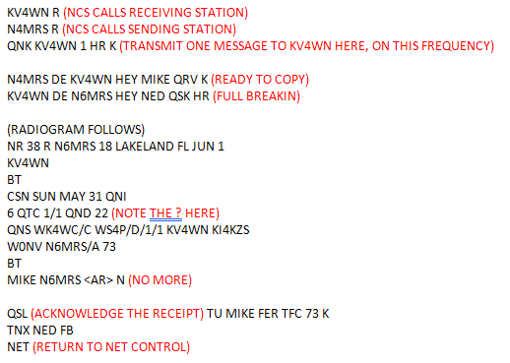
CSN Recording Passing Traffic
Click for recording

Slide 10
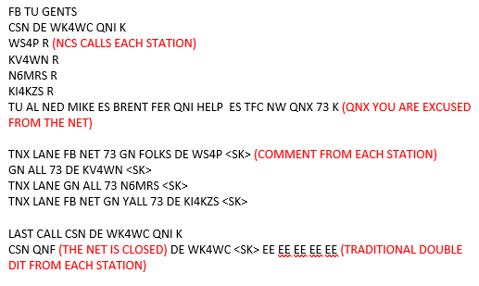
CSN Recording Checking out & Ending the net
Click for recording

Slide 11
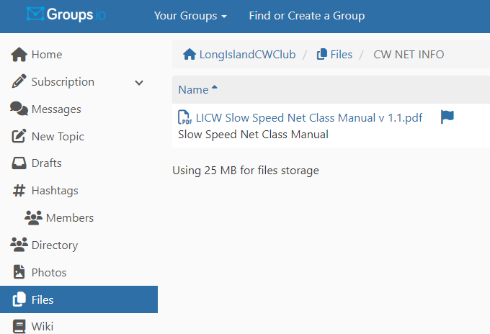
Wrap up
Questions?, Comments
Next Week- The Next Level
V-Band Simulated Net
Net Class Manual

