Slide 1

National Traffic System Net Training
Week 6:
The next level

Slide 2

The Next Level
ARL Numbered Messages
Getting it Right
Book Traffic
Third Party Agreements

Slide 3
Numbered Messages
Summary
Used to reduce the number of word groups
Saves time
Must be "translated" for delivery
"ARL" is added to the check
Resources
FSD-3
NTS2.0 Additions

Slide 4
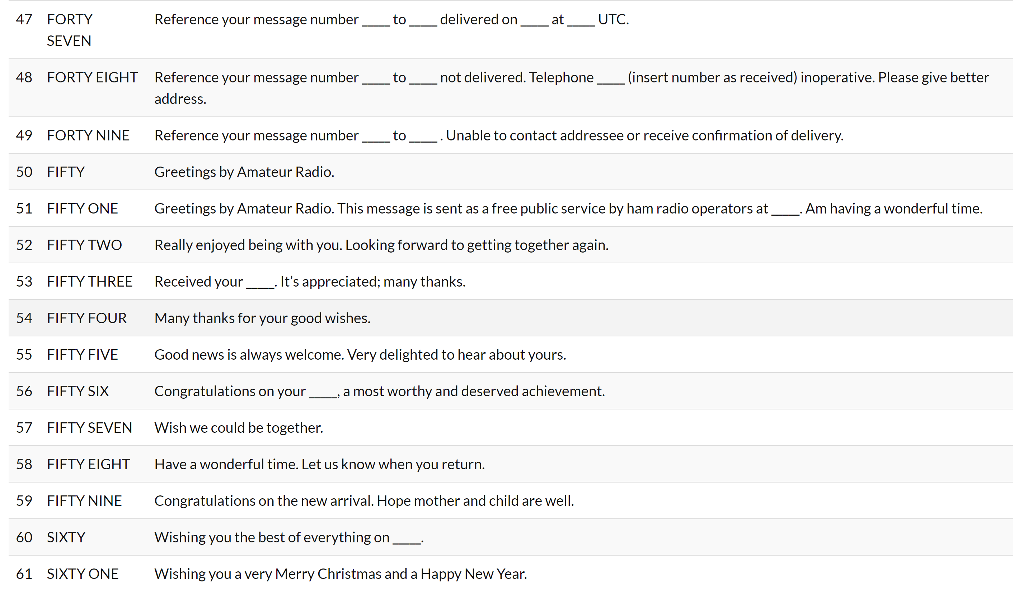
Numbered Messages
FSD-3

Slide 5
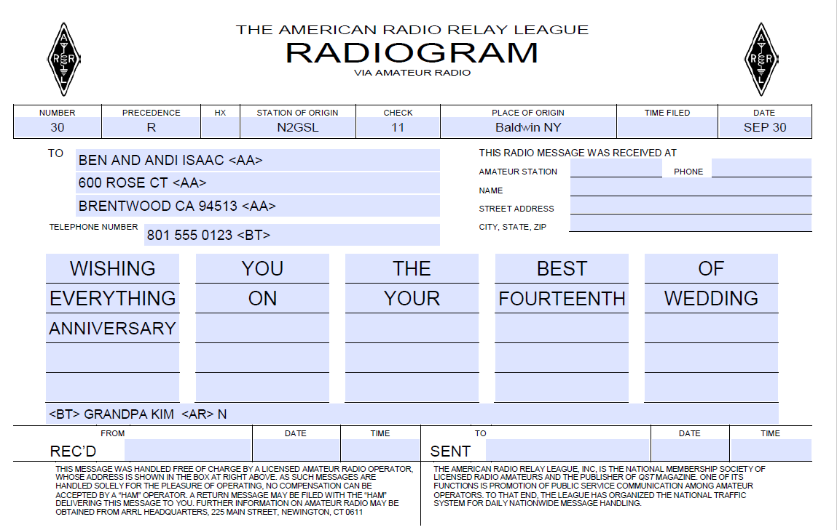
Numbered Messages
Example- Plain Text

Slide 6
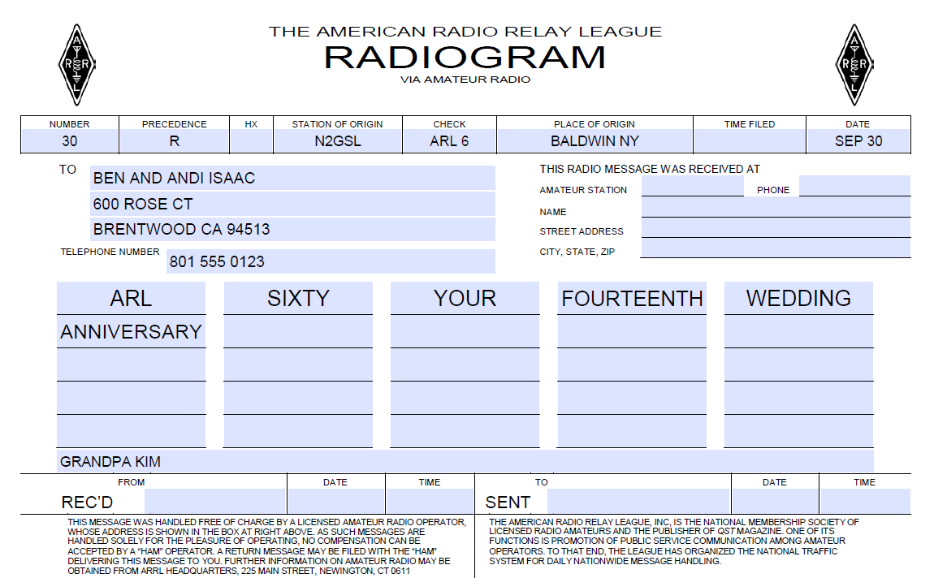
Numbered Messages
Example- Numbered Message

Slide 7
The Next Level
ARL Numbered Messages
Getting it Right
Book Traffic
Third Party Agreements

Slide 8
Getting it Right
Skills
Getting Fills
QTB
Resource
FSD-218

Slide 9
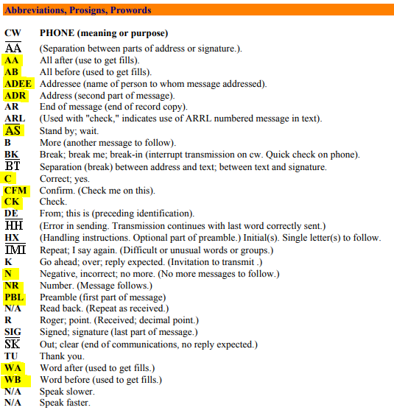
Fills
Skills
QSK method (sending dits)
Filling at the End

Slide 10
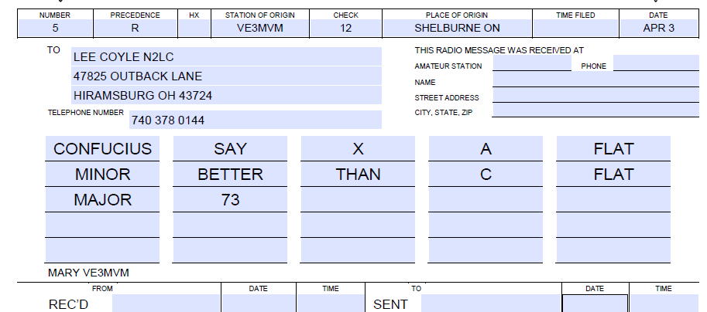
Fills
Example Radiogram

Slide 11
QTB
How it works
QTB means that the number of groups received does not match the check
The Q-signal is sent followed by the first character of each group to identify the error.

Slide 12
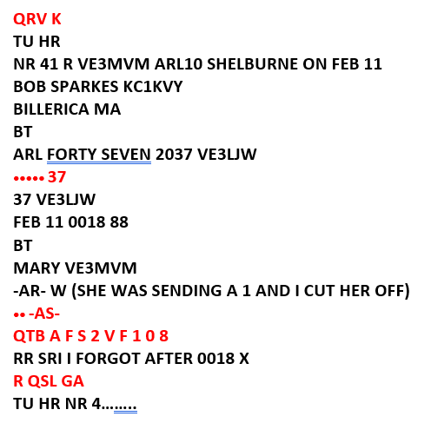

QTB
Example

Slide 13
The Next Level
ARL Numbered Messages
Getting it Right
Book Traffic
Third Party Agreements

Slide 14
Book Traffic
Summary
Usually used for the same message going to multiple adressees
The common parts are sent
The unique parts are sent second
Booking is at the discretion of the sending station

Slide 15
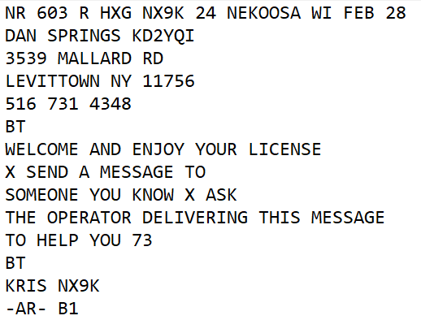
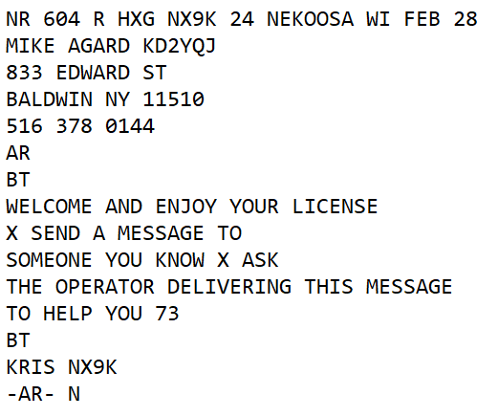
Book Traffic
“unBooked”

Slide 16
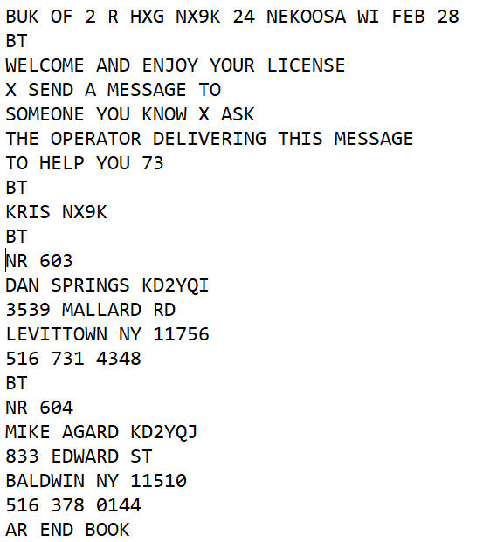
Book Traffic
“Booked”

Slide 17
The Next Level
ARL Numbered Messages
Getting it Right
Book Traffic
Third Party Agreements

Slide 18
Third Party Agreements
Summary
An agreement between the US and a foreign government to allow for third party traffic
The traffic must be non-commercial and of a personal, unimportant nature
A third party is someone who is not involved in passing the traffic and is not a licensed amateur
Resource
Third Party Agreement list

Slide 19
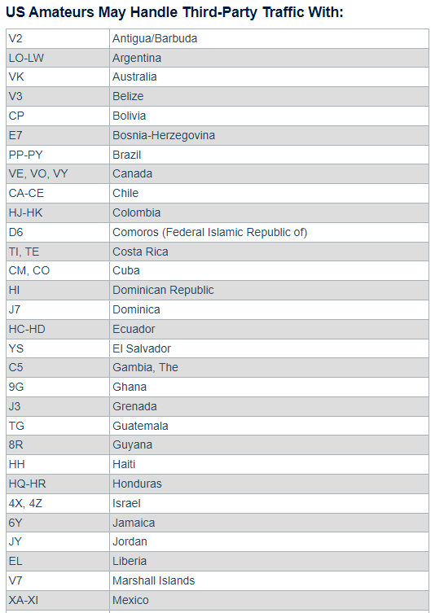
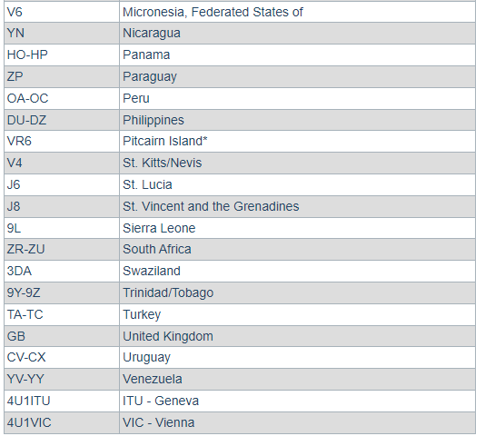
Third Party Agreements

Slide 20
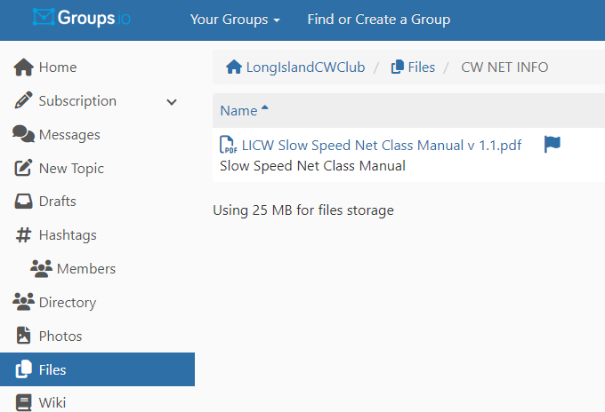
Wrap up
Questions?, Comments
Next Week- The Next Level
V-Band Simulated Net
Net Class Manual

