Slide 1

National Traffic System Net Training
Week 6 – Part 2:
But wait, there’s more

Slide 2

But wait, there’s more
Record Keeping
Net Calls

Slide 3
Record Keeping
Types
During a net
Individual radiograms
Station Activity Report (SAR)/Public Service Honor Roll (PSHR)
Resources
FSD-218
ARRL PSHR

Slide 4
During a net
Skills
Keep track of what’s going on: check-ins, listed traffic, etc.
Helps with “situational awareness” to be able to react and respond appropriately

Slide 5
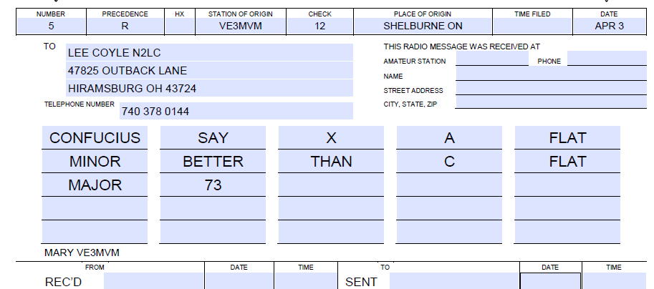
Individual Radiograms
Example Radiogram
Fill out the Received and Sent information in case later tracking is needed and for your Station Activity Report

Slide 6
SAR/PSHR
Summary
The SAR is used to communicate your station’s activity to the ARRL for tracking NTS activity
The PSHR is used by the ARRL to recognize a station’s public service by publication in QST

Slide 7
PSHR Categories
1: Participation in a net: 1pt (40max)
The PSHR threshold is a total of 70 points in the following categories
2: Handling traffic: 1pt per each radiogram originated, received, transmitted, or delivered (40max)
3: ARRL volunteer position: 10pts (30 max)
4: Participation in public events (marathon, parade, etc): 5pts/hr
5: Participation in an emergency response: 5pts/hr
6: Providing and maintaining an automated digital system: 10pts
ARRL PSHR link

Slide 8
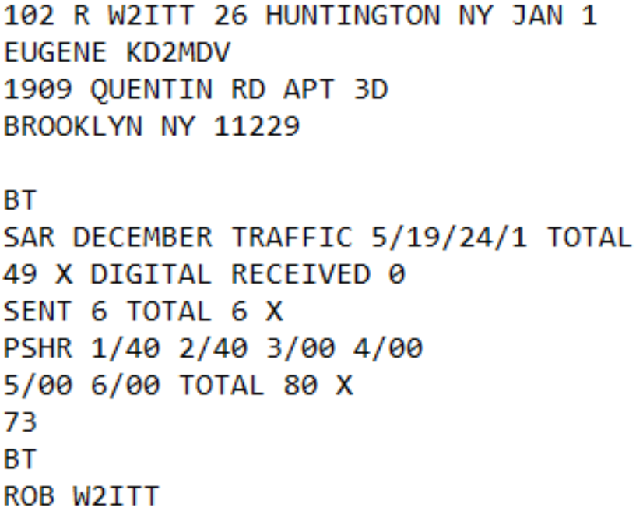
Example SAR

Slide 9
But wait, there’s more
Record Keeping
Net Calls

Slide 10
Net Calls
Procedure part 1
At some point, the NCS may call you and ask you to make a net call to QNI stations that can not be checked in by the net station due to propagation. This will take the form of “NET CALL PSE”, depending on net and NCS
Make a net call as if you were the NCS. “(net name) de (your call) QNI K”

Slide 11
Net Calls
Procedure part 2
The QNI information is transferred to the NCS in different ways depending on the net.
The traffic status is sent with the station’s call: “W2ITT/QRU GE ROB –AS-”
The checked in stations are sent as a list just before returning control to the NCS: “QNS W2ITT/QRU WK4WC QTC SC 1”
Control is returned to the NCS with “NET”, “NIL”, or something similar

